Slide 1
Factors Determining Distribution of Spinal Anesthetics in the Subarachnoid Space
Soli Deo Gloria
Lecture 8
Developing Countries Regional Anesthesia Lecture Series
Daniel D. Moos CRNA, Ed.D. U.S.A. moosd@charter.net

Slide 2
Disclaimer
Every effort was made to ensure that material and information contained in this presentation are correct and up-to-date. The author can not accept liability/responsibility from errors that may occur from the use of this information. It is up to each clinician to ensure that they provide safe anesthetic care to their patients

Slide 3
Spinal Anesthesia
Small amounts of local anesthetic injected into the subarachnoid space results in a reversible loss of sensation and motor function.
Needle is placed below L2 to avoid trauma to the spinal cord.

Slide 4
Surgical Procedures
Any procedure below the umbilicus
Obstetric/gynecological procedures of uterus and perineum
Hernia repairs
Genitourinary procedures
Orthopedic procedures from the hip down

Slide 5
Advantages
Easy to perform
Reliable
Excellent operating conditions
Less costly than general anesthesia
Gastrointestional function returns faster than a general
Patient maintains a patent airway
Decreased pulmonary complications
Decreased incidence of deep vein thrombosis and pulmonary emboli

Slide 6
Disadvantages
Risk of failure…must be prepared to induce general anesthesia
Normal alteration in hemodynamics. Patient must be monitored with ECG, blood pressure, and pulse oximetry. Resuscitation equipment and medications should be available.
Risk of complications which will be covered later.

Slide 7
Absolute Contraindications Spinal
Patient refusal
Infection at the site of injection
Coagulopathy
Severe hypovolemia
Increased Intracranial pressure
Severe Aortic Stenosis
Severe Mitral Stenosis
Ischemic Hypertrophic Sub-aortic Stenosis

Slide 8
Relative Contraindications
Sepsis
Uncooperative patients
Pre-existing neuro deficits/neurological deficits
Demylenating lesions
Stenotic valuvular heart lesions (mild to moderate Aortic Stenosis/Ischemic Hypertrophic Sub-aortic Stenosis)
Severe spinal deformities

Slide 9
Controversial
Prior back surgery
Inability to communicate with the patient
Complicated surgeries that may involved prolonged periods of time to perform, major blood loss, maneuvers that may complicate respiration

Slide 10
Mechanism of Action for Spinal Anesthetics
Local anesthetic solutions block sensory, autonomic and motor impulses as the anterior and posterior nerve roots pass through the CSF. It is NOT the spinal cord!
The site of action includes the spinal nerve roots and the dorsal root ganglion.

Slide 11
Uptake & Elimination- 4 Factors
Concentration of local anesthetic in the CSF
Surface area of neuronal tissue exposed in the CSF
Lipid content of the neuronal tissue
Blood flow to the tissue

Slide 12
Uptake & Elimination
Concentration is highest at the point of injection
Spinal nerve roots are easily blocked since they do not contain an epineurium
As the local anesthetic travels away from the site of injection it is diluted secondary to absorption into tissue and dilution by CSF.

Slide 13
Uptake & Elimination
Though the spinal cord is not the site of action it does absorb local anesthetics into the pia mater and the spaces known as Virchow-Robin which are extensions of the subarachnoid space.

Slide 14
Uptake & Elimination
Elimination occurs through vascular absorption in the subarachnoid and epidural space.
Initial vascular uptake occurs in the blood vessels of the pia mater and spinal cord.
Rate of absorption is proportional to the surface area that the local anesthetic is exposed to.

Slide 15
Uptake & Elimination-
Lipid solubility of the local anesthetic also enhances uptake and diminished concentration.
Local anesthetics diffuse into the epidural space along a concentration gradient.
Once in the epidural space the local anesthetic diffuses into the vasculature.

Slide 16
Factors
15 factors are identified as playing a role in the block height.
Some play a minor role, some play a major role, some you have some control, others you don’t.

Slide 17
Factors
The 15 factors can be divided into 4 main categories:
Characteristics of anesthetic medication
Patient characteristics
Technique of injection
Characteristics of spinal fluid

Slide 18
Characteristics of the Anesthetic Solution
Multiple characteristics of the anesthetic solution will affect the spread of local anesthetic. This includes the density, dose, concentration, temperature, and volume.

Slide 19
Definitions
Density- weight of 1 ml of solution in grams at a standard temperature.
Specific Gravity- density of a solution in a ratio compared to the density of water.
Baracity- the ratio comparing the density of one solution to another.

Slide 20
Density
Exerts one of the greatest effects on the spread of local anesthetic within the subarachnoid space.
Dependent upon the specific gravity of the solution in relation to the CSF environment.
CSF at 37 degrees C has a specific gravity of 1.003-1.008.

Slide 21
Baricity
Based on the normal specific gravity of CSF (1.003-1.008) a local anesthetic solution may be hyperbaric, isobaric, or hypobaric.

Slide 22
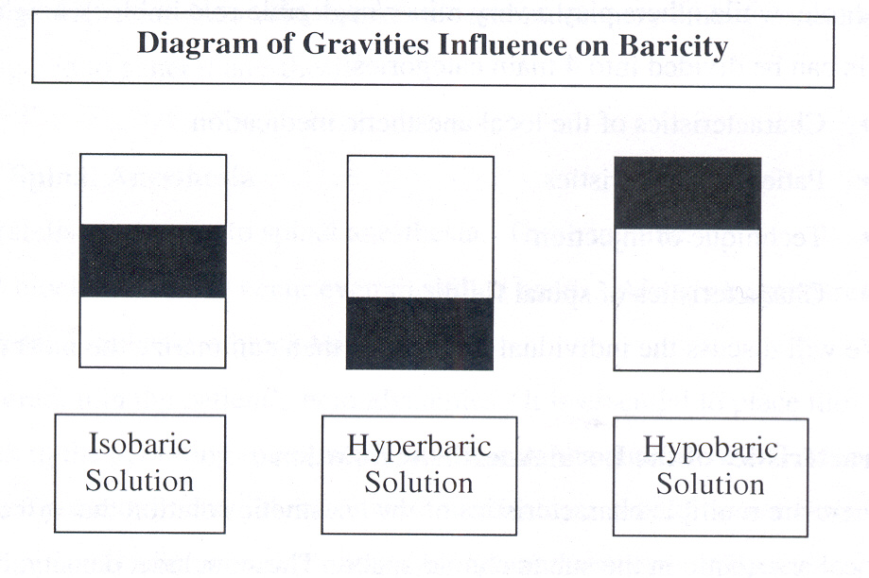
Baracity

Slide 23
Baricity
Hyperbaric means that the solution is ‘heavier’ than the CSF. This is one of the most common forms of local anesthetic used. A local anesthetic is made to be hyperbaric by adding dextrose to the solution.

Slide 24
Baricity
Isobaric solutions generally have the same specific gravity as the CSF. Generally the medication will spread within the area of injection. The solution may be already manufactured as an isobaric solution or you may mix your local anesthetic solution with CSF in a 1:1 ratio.

Slide 25
Baricity
Hypobaric solutions are ‘lighter’ than the CSF. This means they will move in a cephalad direction as opposed to the hyperbaric movement in a caudad direction. Hypobaric solutions can be created by adding sterile water to the solution.

Slide 26
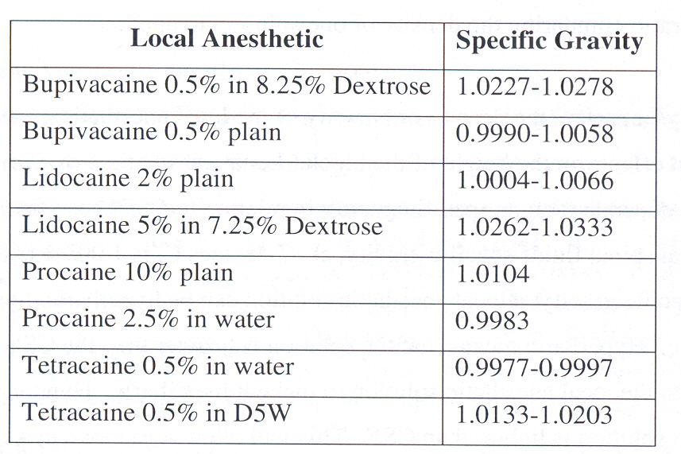
Baricity- Common Spinal Local Anesthetic

Slide 27
Baricity
Head down position- hyperbaric solution will move cephalad; hypobaric solution will move caudad.
Head up position- hyperbaric solution will move in a caudad direction; hypobaric solution will move in cephalad direction.
Lateral position- hyperbaric solution will move toward the dependent area; hypobaric solution will move towards the non-dependent area.
Isobaric solutions- will stay in the general area of injection regardless of the position.

Slide 28
Baricity
In general hyperbaric solutions will be limited in movement when the patient is placed supine. It should not transverse the apex of the thoracic kyphosis unless the dose or volume is large enough to transverse this area. As you monitor the progress of your block you can influence the spread by placing your patient in trendelenburg or reverse trendelenburg position.

Slide 29
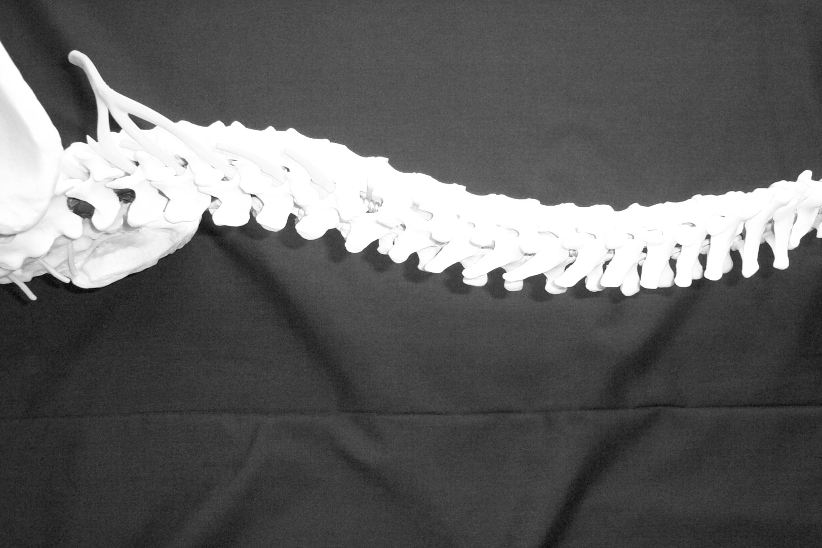
Baricity
Lumbar 4,3,2 Thoracic 7,6,5

Slide 30
Other Characteristics of Local Anesthetic Solution
Dose- the larger the dose the higher the block.

Slide 31
Other Characteristics of Local Anesthetic Solution
Concentration- the higher the concentration the higher the block
Temperature- very minor but if the solution is cold it will be more viscous and spread less; the opposite is true for warm solutions.
Volume- the greater the volume the greater the spread.

Slide 32
Patient Characteristics

Slide 33
Patient Characteristics
Age
Height
Intra-abdominal pressure
Anatomic configuration of the spinal cord
Patient position (during and after injection)

Slide 34
Age
Minor role
Anatomical changes as we age occur that may raise the height of the block
Similar doses of isobaric bupivacaine administered to patients in the 20’s and greater than 80 years found a 3 level difference.

Slide 35
Height
Minor role- unless extremes

Slide 36
Intra-abdominal Pressure
Engorgement of epidural veins causes a decrease in CSF volume which results in a higher block.
Conditions that may increase intra-abdominal pressure include:

Slide 37
Pregnancy
Local anesthetic does in full term parturient should be decreased by 1/3rd to achieve the same height as a non-parturient.

Slide 38
Additional Conditions: Increased Intra-abdominal Pressure
Obesity
Ascites and Abdominal Tumors

Slide 39
Anatomic Configuration of the Spinal Cord
Normal anatomic curvature influences the spread of hyperbaric solutions.

Slide 40
This includes the natural lardosis
L2, L3, L4 Region

Slide 41
And natural thoracic kyphosis
T7, T6, T5 Region

Slide 42
Normal Spinal Configuration
When medications are injected above L3 and the patient is placed in a supine position the medication will spread cephalad until it reaches the T4 curvature which should limit its spread.

Slide 43
Abnormal Spinal Configuration
Abnormal changes in the anatomy of the spine may result in a decrease in the volume of CSF and subsequently increase the height of your block.
Conditions include kyphosis, kyphoscolosis, and lardosis.

Slide 44
Patient Position
Patient position during administration and immediately after administration will impact your level. This is largely the function of the baricity of the anesthetic solution.

Slide 45
Patient Position
Administration of a hyperbaric solution in a sitting position may result in a higher concentration in the lower lumbar and sacral areas.
Lateral position- greater concentration of local anesthetic in the dependent area with hyperbaric solutions.
Jack Knife position- greater concentration of local anesthetic in the non-dependent area with hypobaric solutions.

Slide 46
Patient Position
Immediately after a hyperbaric solution a trendelenburg position may help spread the local anesthetic higher.

Slide 47
Patient Position
A reverse trendelenburg position is helpful to limit the cephalad spread of local anesthetic.

Slide 48
Technique of Injection
Site of injection: the level that you place the local anesthetic will influence the spread of local anesthetic. If you place your medication at L2 it will cover higher levels than if you injected it at L5.

Slide 49
Technique of Injection- site of injection
The level of injection will influence spread. A greater spread of local anesthetic will occur if injected at L2-L3 as opposed to L5-S1.

Slide 50
Technique of Injection
Direction of the needle- if the local anesthetic is injected cephalad it will spread further than if injected in a lateral or caudad direction.
It does NOT appear that rate of injection (except isobaric), barbatoge, coughing, or straining affects the height of the block.

Slide 51
Characteristics of the Spinal Fluid
Volume and density of the spinal fluid will affect the height of the subarachnoid block.
CSF volume is inversely related to height block. Decreased volumes will have a greater spread and visa versa.

Slide 52
Characteristics of the Spinal Fluid
CSF density- has an impact on the spread of local anesthetic based on the baricity of the local anesthetic.
If CSF is concentrated or alternatively dilute with a higher or lower than normal specific gravity this will impact the movement of the local anesthetic medication.

Slide 53
So what does not impact the height of your spinal block?
Vasoconstrictors
Coughing, straining, baring down, barbotage
Rate of injection (except isobaric)
Gender
Weight

Slide 54
Factors that affect the height of your block that you have no control of:
Volume of CSF
Density of CSF

Slide 55
Factors that you have control of:
Dose (volume/concentration)
Site of injection
Baricity of local anesthetics
Posture of the patient during and after the administration of local anesthetic

Slide 56
Summary: So what are the most important factors that influence your block height?
Baricity of local anesthetic solution
Position of the patient during and immediately after the injection
Drug dosage
Site of injection

Slide 57
References
Ankcorn, C. & Casey W.F. (1993). Spinal Anaesthesia- A Practical Guide. Update in Anaesthesia. Issue 3; Article 2.
Brown, D.L. (2005). Spinal, epidural, and caudal anesthesia. In R.D. Miller Miller’s Anesthesia, 6th edition. Philadelphia: Elsevier Churchill Livingstone.
Burkard J, Lee Olson R., Vacchiano CA. Regional Anesthesia. In JJ Nagelhout & KL Zaglaniczny (eds) Nurse Anesthesia 3rd edition. Pages 977-1030.
Casey W.F. (2000). Spinal Anaesthesia- A Practical Guide. Update in Anaesthesia. Issue 12; Article 8.
Dobson M.B. (2000). Conduction Anaesthsia. In Anaesthesia at the District Hospital. Pages 86-102. World Health Organization.
Kleinman, W. & Mikhail, M. (2006). Spinal, epidural, & caudal blocks. In G.E. Morgan et al Clinical Anesthesiology, 4th edition. New York: Lange Medical Books.
Reese, C.A. (2007). Clinical Techniques of Regional Anesthesia. Park Ridge, Il: AANA Publising.
Warren, D.T. & Liu, S.S. (2008). Neuraxial Anesthesia. In D.E. Longnecker et al (eds) Anesthesiology. New York: McGraw-Hill Medical.

