Slide 1
Physiologic Effects of Neuraxial Blockade
Soli Deo Gloria
Lecture 7
Developing Countries Regional Anesthesia Lecture Series
Daniel D. Moos CRNA, Ed.D. U.S.A. moosd@charter.net

Slide 2
Disclaimer
Every effort was made to ensure that material and information contained in this presentation are correct and up-to-date. The author can not accept liability/responsibility from errors that may occur from the use of this information. It is up to each clinician to ensure that they provide safe anesthetic care to their patients.

Slide 3
Introduction
Neuraxial blockade has specific physiologic consequences. For example hypotension is not a complication per se but a normal manifestation of neuraxial blockade.
Understanding these effects will allow you to anticipate them and treat them in a timely manner so complications do not occur.

Slide 4
Neuraxial Blockade Mechanism of Action
The site of action for either spinal or epidural anesthesia is the nerve root.
Local anesthetics administered in the subarachnoid space interact with the spinal root within that space.
Small dose and volume of local anesthetic produces a dense sensory and motor blockade.

Slide 5
Neuraxial Blockade Mechanism of Action
Local anesthetics administered in the epidural space will interact with the spinal nerve root in that space.
The epidural space is a potential space and higher volumes of local anesthetics must be administered to spread the local anesthetic to the desired spinal nerve roots for the proposed surgical procedure.

Slide 6
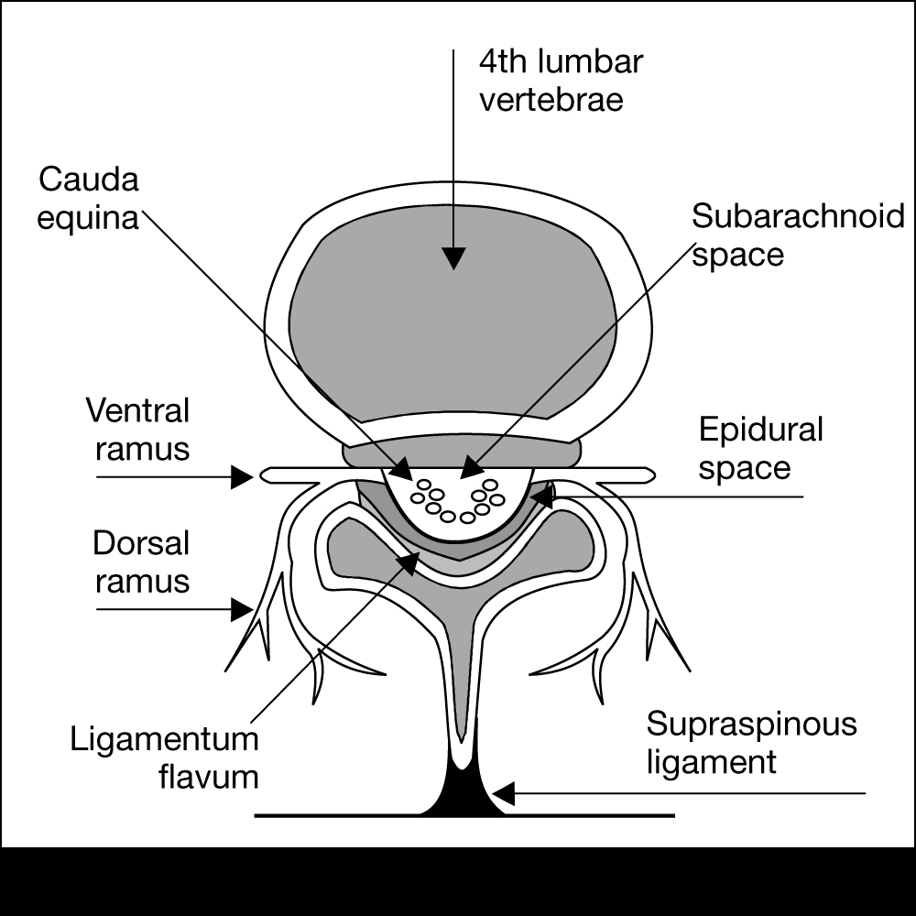
Blockade of the Anterior (ventral) Nerve Roots Fibers

Slide 7
Blockade of the Anterior (ventral) Nerve Roots Fibers
Blockade of the anterior (ventral) nerve root fibers results in blockade of the efferent motor and autonomic transmission.

Slide 8
Blockade of the Posterior (dorsal) Nerve Root

Slide 9
Blockade of the Posterior (dorsal) Nerve Root
Results in blockade of the somatic and visceral impulses.

Slide 10
Somatic Blockade
Neuraxial anesthesia blocks sensory and motor transmission.
Sensory blockade involves somatic and visceral painful stimulation.
Motor blockade involves blockade of the skeletal muscle.

Slide 11
Differential Blockade
Is a phenomenon by which there are areas which have differences in sensation. For example some areas are insensitive to pressure whereas other areas can still sense pressure, or temperature, or pin prick sensation, etc.

Slide 12
Somatic Blockade and the Phenomenon of Differential Blockade
Divided into local anesthetic factors and anatomical factors.

Slide 13
Somatic Blockade and the Phenomenon of Differential Blockade
Local anesthetic factors include the concentration of local anesthetic and the duration of contact with the spinal nerve root.
As local anesthetic spreads out from the initial point of injection the concentration becomes less which may effect which nerve fibers are susceptible to blockade.

Slide 14
Somatic Blockade and the Phenomenon of Differential Blockade
Anatomical factors are related to the variety of fiber types found in each nerve root.
Small myelinated fibers are easier to block than large unmyelinated fibers.
Sympathetic block is generally 2-6 dermatomes higher than sensory which is generally 2 dermatomes higher than the level of motor blockade.

Slide 15
Autonomic Blockade
Neuraxial blockade blocks efferent autonomic transmission producing a sympathetic block and partial parasympathetic block.
Sympathetic nerve fibers are small and myelinated and thus easier to block.

Slide 16
Autonomic Blockade
The Sympathetic Nervous System is described as thoracolumbar since sympathetic fibers exit the spinal cord from T1-L2.
During the administration of a neuraxial block you will seen a sympathetic block prior to sensory which occurs before a motor block.

Slide 17
Autonomic Blockade
The Parasympathetic Nervous System is described as craniosacral since parasympathetic fibers exit the CNS in the cranial and sacral areas.
Neuraxial blockade does not effect the vagus nerve (10th cranial nerve).
Since the PNS is only partially blocked the end result is a decreased sympathetic tone with an unopposed parasympathetic tone.
This imbalance will result in many of the expected alteration in normal homeostasis noted during neuraxial blockade.

Slide 18
Cardiovascular Effects

Slide 19
Neuraxial blockade can impact the CV system in the following ways:
Decreased Blood Pressure
Decreased Heart Rate
Decreased cardiac contractility

Slide 20
Sympathectomy
Term used to describe the effect of blocking the sympathetic outflow.
Nerve fibers that affect the vasomotor tone of arterial and venous vessel tone arise from T5-L1 (the area that we often want to block).
The sympathetic dermatome is 2-6 levels higher than the sensory block.

Slide 21
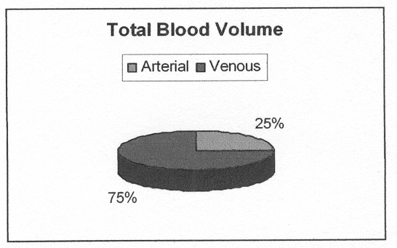
Sympathectomy
The level of sympathectomy is directly related to the height of the block.
The venous system contains about 75% of the total blood volume while the arterial system contains about 25% of the total blood volume.

Slide 22
Sympathectomy
The dilation of the venous system is predominantly responsible for the decrease in blood pressure.
The arterial system is able to maintain much of its vascular tone.
Total peripheral vascular resistance will decrease 15-18% in the normal patient.
In the elderly the systemic vascular resistance will decrease as much as 25% with a 10% decrease in cardiac output.

Slide 23
Heart Rate
Heart rate may decrease if you block the cardioaccelerator fibers (T1-T4).
Heart rate may also decrease as a result of a decrease in SVR which decreases right atrial filling which decreases intrinsic chronotropic stretch receptor response

Slide 24
Decrease in Heart Rate
2. Results in decreased right atrial filling
3. Results in decreased stimulation of intrinsic chronotropic receptors
4. Results in decreased heart rate
1. Decreased SRV

Slide 25
Blood Pressure
No set criteria on how low it should go.
Depends on co-existing diseases.
Not unreasonable to allow a modest decrease but to treat more than a 20% decline.
Spinal anesthesia has some protective effects by decreasing the total body oxygen consumption.

Slide 26
Blood Pressure
Severe hypotension may be due to a collusion of vasodilation, bradycardia, and decreased contractility.
Hypotension aggravated by the weight of a gravid uterus and venous return in the parturient or a head up position
Occasional cardiac arrest is seen during spinal anesthesia due to unopposed to vagal stimulation- vigilance is required as well as prompt treatment of bradycardia.

Slide 27
Anticipate the CV changes
Volume load the patient with 10-20 ml/kg of crystalloid (take into account CV history).
Left uterine displacement for the parturient.
Trendelenberg position may help by autotransfusion but make sure the spinal is “set” prior to this or else you may aggravate the situation by creating a very high spinal.

Slide 28
Anticipate the CV changes
Bradycardia should be promptly treated by atropine.
Hypotension should be treated with phenylephrine which is an alpha adrenergic agonist- increases venous tone and arterial constriction.
If hypotension is present with bradycardia then phenylephrine may not be the best choice.

Slide 29
Anticipate the CV changes
Phenylephrine may cause reflex bradycardia in conjunction with increased venous tone.
Ephedrine is a good choice since it has direct beta adrenergic effects which increase the heart rate and contractility as well as some indirect vasoconstriction.

Slide 30
Anticipate the CV changes
Profound bradycardia and hypotension that persists despite treatment can be treated with epinephrine in doses of 5-10 mcg titrated until you achieve the desired response.

Slide 31
Respiratory Effects

Slide 32
Respiratory Effects
Neuraxial blockade plays a minor role in altering pulmonary function
High thoracic blocks leave tidal volume unchanged and there is only a slight decrease in vital capacity from loosing abdominal muscles
Phrenic nerve is innervated by C3-C5 and is responsible for the function of the diaphragm

Slide 33
Respiratory Effects
The phrenic nerve is very difficult to block even with a high spinal.
Apnea related to a high spinal or total spinal is not thought to be due to phrenic nerve block but related to brainstem hypoperfusion
This is based on the fact that spontaneous respiration returns when hemodynamic resuscitation has occurred

Slide 34
However co-existing morbidities should be carefully considered when choosing neuraxial blockade- especially if the patient has severe lung disease.

Slide 35
Why?
Patients with chronic lung disease depend on the intercostal and abdominal muscles to help with inspiration and expiration.
Neuraxial blockade of these muscles may have a negative impact on the ability rely on these muscles for respiration and the clearing of secretions

Slide 36
Severe Lung Disease
For procedures above the umbilicus the choice of a pure regional anesthetic may not be the best choice for the patient.
Postoperative analgesia with an epidural is helpful. Thoracic and abdominal surgery is associated with decreased phrenic nerve activity related to surgical trauma.

Slide 37
Severe Lung Disease
Decreased phrenic nerve activity leads to decreased diaphragm activity, decreased FRC leading to atelectasis and hypoxia due to ventilation/perfusion mismatching

Slide 38
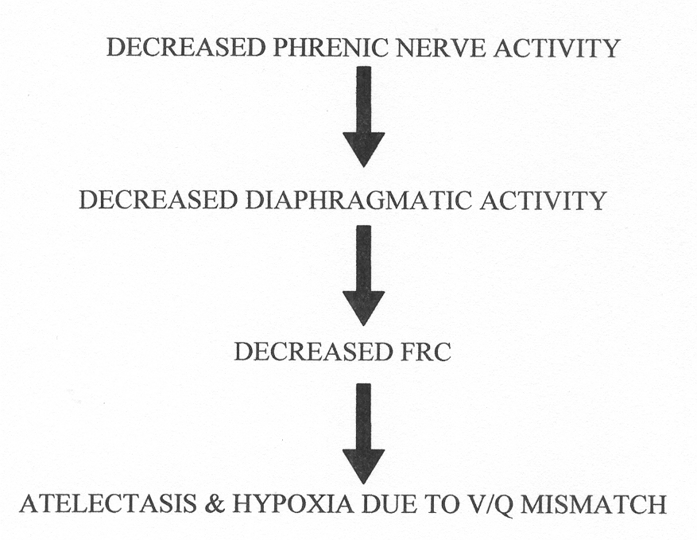
Consequences of thoracic and abdominal surgery

Slide 39
Positive Benefits of Postoperative Thoracic Epidural Analgesia
Decreased incidence of pneumonia
Decreased incidence of respiratory failure
Improved oxygenation
Decreased amount of time required for postoperative ventilation

Slide 40
Gastrointestinal Effects

Slide 41
GI Effects
Sympathetic outflow originates from T5-L1
Once blocked PSN predominates
Results: small contracted gut with peristalsis
Hepatic blood flow decreases in accordance to mean arterial pressure and doesn’t differ with anesthetic techniques
Postoperative epidural analgesia enhances return of GI function

Slide 42
Renal Effects

Slide 43
Renal Effects
Neuraxial blockade has little effect on the blood flow to the kidneys
Autoregulation maintains renal blood flow
Neuraxial blockade does block sympathetic & parasympathetic control of the bladder at the lumbar and sacral levels.
Result: loss of autonomic bladder control

Slide 44
Renal Effects
When placing neuraxial blockade take this in consideration
If no urinary catheter consider limiting fluids, short acting anesthetics, and monitor the bladder for signs of over distention. May consider straight cath.
Patients with BPH at increased risk for this

Slide 45
Metabolic and Endocrine Effects

Slide 46
Metabolic and Endocrine Effects
Surgical trauma produces a host of neuro-endocrine responses related to the inflammatory response and activation of somatic and visceral afferent nerve fibers.

Slide 47
Some substances released in response to surgical trauma
Adrenocorticotropic hormone
Cortisol
Epinephrine
Norepinephrine
Vasopressin
Activation of renin-angiotension-aldosterone system

Slide 48
Clinical Manifestations of the Neuroendocrine Response
Hypertension
Tachycardia
Hyperglycemia
Protein Catabolism
Depressed Immune System
Alteration of Renal Function

Slide 49
Metabolic and Endocrine Effects
Neuraxial blockade may effectively block this or partially block this response
To be wholly effective the block should be extended into the postoperative period
Positive effects of neuraxial blockade include reduced catecholamine release, decreased stress related arrhythmias, and possibly ischemia.

Slide 50
Epidural Specific Effects
Overall the same systemic effects between spinal and epidural. Main difference is the amount of local anesthetic used and the potential for systemic effects from the local anesthetic when used for epidural anesthesia

Slide 51
References
Brown, D.L. (2005). Spinal, epidural, and caudal anesthesia. In R.D. Miller Miller’s Anesthesia, 6th edition. Philadelphia: Elsevier Churchill Livingstone.
Kleinman, W. & Mikhail, M. (2006). Spinal, epidural, & caudal blocks. In G.E. Morgan et al Clinical Anesthesiology, 4th edition. New York: Lange Medical Books.
Reese, C.A. (2007). Clinical Techniques of Regional Anesthesia. Park Ridge, Il: AANA Publising.
Warren, D.T. & Liu, S.S. (2008). Neuraxial Anesthesia. In D.E. Longnecker et al (eds) Anesthesiology. New York: McGraw-Hill Medical.

