Slide 1
Dermatome Levels
Soli Deo Gloria
Lecture 6
Developing Countries Regional Anesthesia Lecture Series
Daniel D. Moos CRNA, Ed.D. U.S.A. moosd@charter.net

Slide 2
Disclaimer
Every effort was made to ensure that material and information contained in this presentation are correct and up-to-date. The author can not accept liability/responsibility from errors that may occur from the use of this information. It is up to each clinician to ensure that they provide safe anesthetic care to their patients.

Slide 3
Dermatome Level
Assessing the dermatome level after neuraxial blockade helps to determine if the block is adequate for the proposed surgical procedure.
Differential blockade plays a role in your assessment of blockade height.

Slide 4
Differential Blockade-the why?
Injection of local anesthetic will reach spinal nerve roots
Blockade of nerve impulse transmission occurs
Spinal nerve roots contain several nerve fiber types and classifications- some are more susceptible to local anesthetics than others

Slide 5
Differential Blockade-Local Anesthetic Factors
As local anesthetic spreads you see a smaller concentration of local anesthetic at sites distal to the injection
Local anesthetic concentration and duration of contact plays a role
Susceptibility of nerve fiber types to be blocked

Slide 6
Differential Blockade-Anatomic Factors
Small mylelinated fibers are more susceptible to blockade
Large unmyelinated fibers are less susceptible to blockade
Thus there is a difference between the sympathetic level, sensory level, and motor levels

Slide 7
How Big of a Difference?
The sympathetic level is generally 2-6 levels higher than the sensory level. The sensory level is generally 2 levels higher than the motor level

Slide 8
Testing Levels-Sympathetic
An alcohol wipe can be used to test the level of sympathetic blockade. You are testing the patients ability to differentiate differences in skin temperature discernment

Slide 9
Testing Levels-Sensory Level
Use a blunt needle that is sharp enough to produce a “pin prick” sensation but not sharp enough to break the skin (i.e. spinal needle stylet)

Slide 10
Dermatome Levels

Slide 11
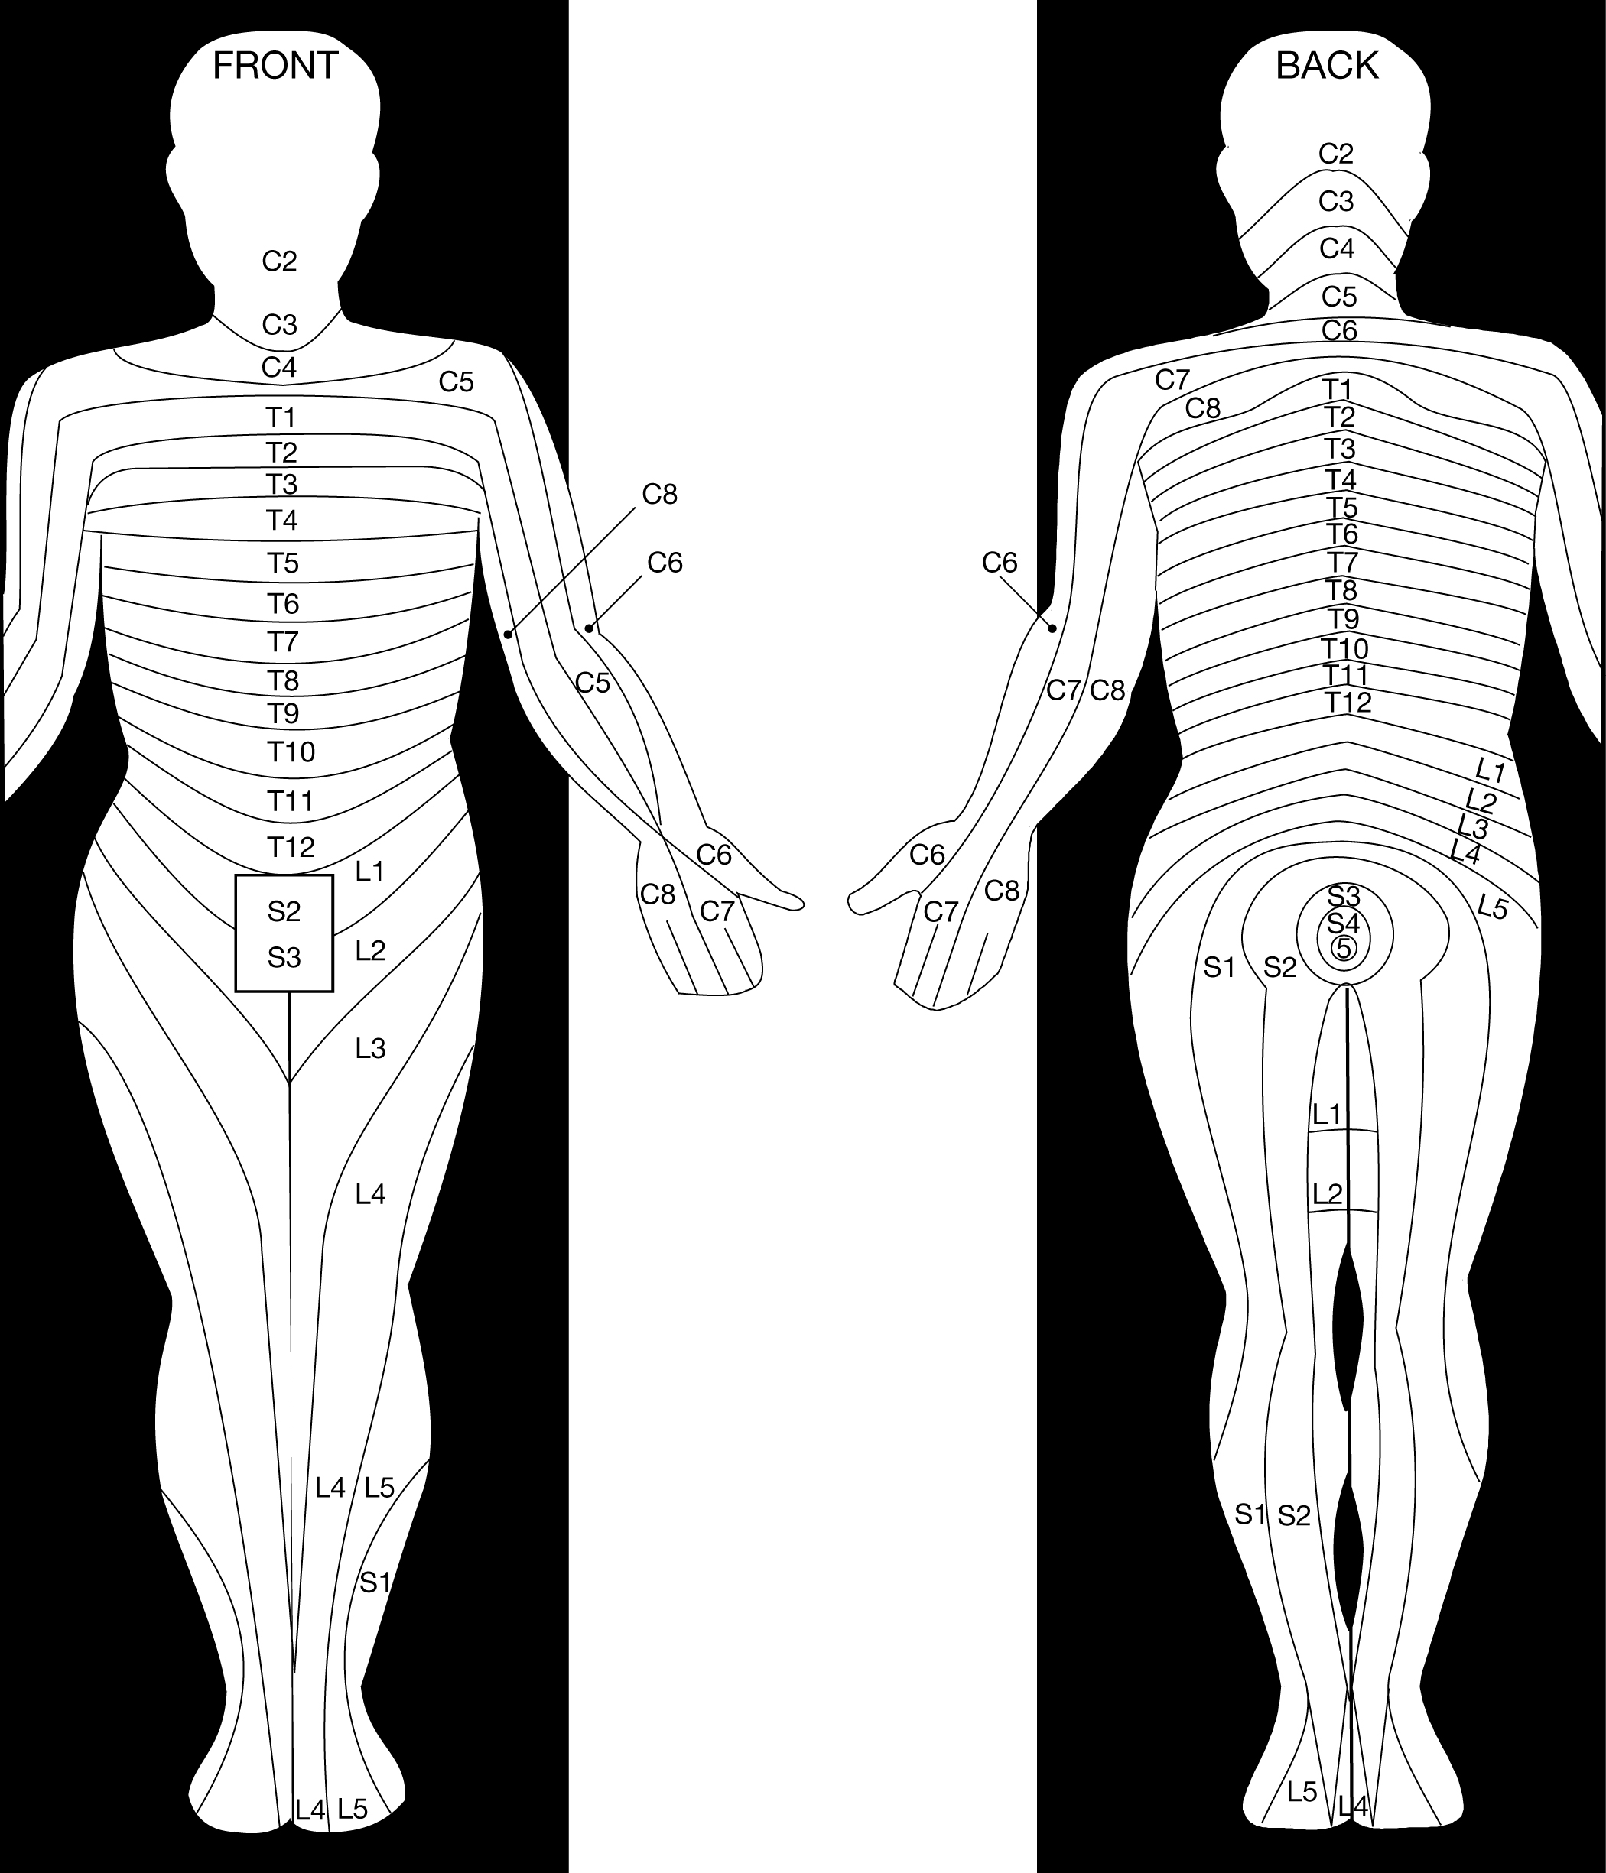

Slide 12
Common operative sites and minimum level of blockade

Slide 13
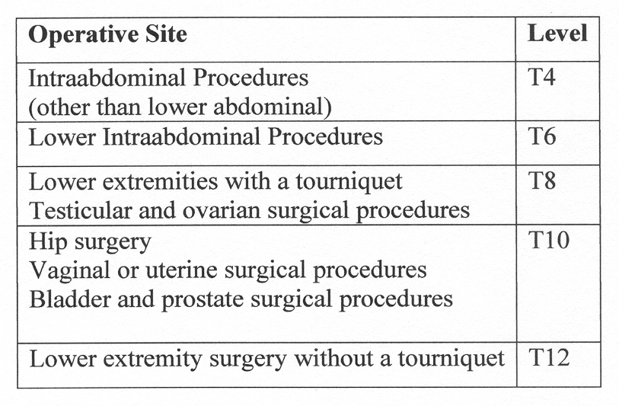

Slide 14
Why are the levels for surgery higher than the area of incision and operation?
Afferent autonomic nerves!
Innervations for visceral sensations and viserosomatic reflexes occur at spinal segments that are much higher than the skin dermatome level of the proposed surgical procedure

Slide 15
Surface Anatomical Landmarks, Dermatome level, and Systemic Effects
Important to know so you can assess if the block is adequate
Important to know to anticipate systemic effects and potential complications
Assessment of inadequate block will allow you to employ an alternative anesthetic technique before incision

Slide 16
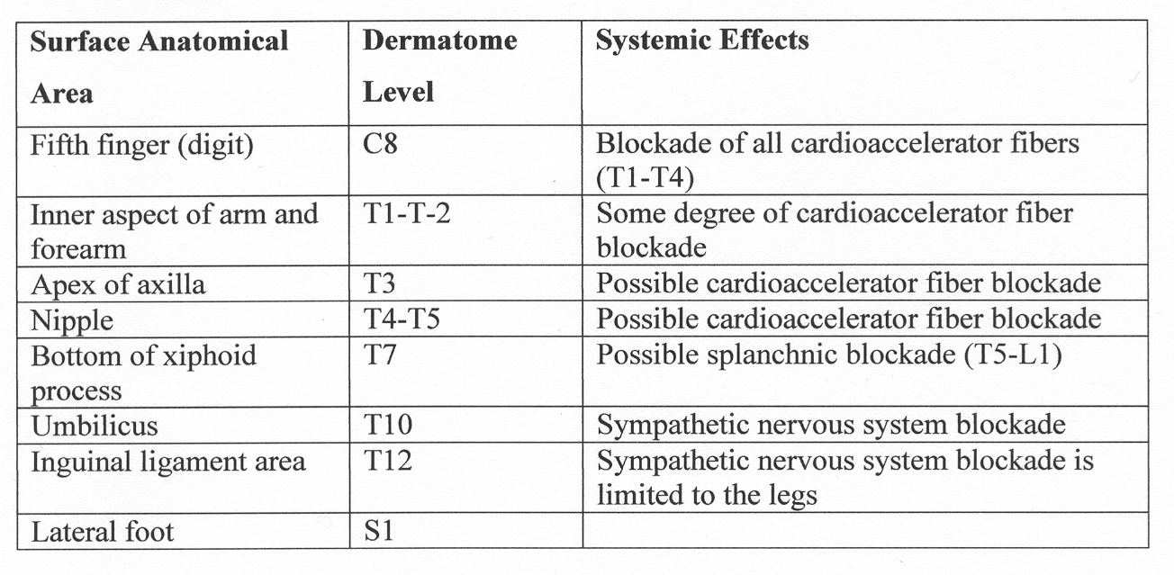

Slide 17
T10 Level (umbilicus)
A T10 Level should provide adequate anesthesia for procedures including:
Hip surgery
Vaginal/uterine surgery
Bladder/prostate surgery
A T12 Level should provide adequate anesthesia for procedures including:
Lower extremity surgery without a tourniquet

Slide 18
T4 Level (nipple)
T4 Level provides adequate anesthesia for intra-abdominal procedures.
T6 Level (Xiphoid Process) provides adequate anesthesia for lower intra-abdominal procedures.

Slide 19
C8 Level (little finger)
A C8 Level is too high. Most likely you have blocked the cardio-accelerator fibers, the patient is hypotensive and may arrest.

Slide 20
Where is T5? A survey of anaesthetists.
T5 is found between T4 (nipple level) and T6 (xiphoid process)
Pain during C-section a common cause of malpractice suits in England.
73 anaesthetists (consultants and trainees) were asked to identify T5 on an anatomical torso model of a non pregnant female.
K Congreve, I Gardner, C Laxton, M Scrutton. Where is T5? A survey of anaesthetists. Anaesthesia, pp. 453-455. 61, 2006.

Slide 21
Where is T5? A survey of anaesthetists.
Purposely used a “non-pregnant” model to prevent landmarks that may be disguised by the physical changes that occur.
K Congreve, I Gardner, C Laxton, M Scrutton. Where is T5? A survey of anaesthetists. Anaesthesia, pp. 453-455. 61, 2006.

Slide 22
Results
1 out of 7 were 2 or more dermatomes away from T5.
Anesthesia providers that “believe” that T5 is higher than where it is actually at may encounter more cardiovascular instability due to blockade of the cardio-accelerator fibers (T1-T4).
K Congreve, I Gardner, C Laxton, M Scrutton. Where is T5? A survey of anaesthetists. Anaesthesia, pp. 453-455. 61, 2006.

Slide 23
Results
Anesthesia providers who “believe” that T5 is lower than where it is may be left with an inadequate block resulting in pain and conversion to general anesthesia.
K Congreve, I Gardner, C Laxton, M Scrutton. Where is T5? A survey of anaesthetists. Anaesthesia, pp. 453-455. 61, 2006.

Slide 24
Take Home Message
Knowledge of “where” the dermatomes are located anatomically are essential and foundational in testing neuraxial blockade.
K Congreve, I Gardner, C Laxton, M Scrutton. Where is T5? A survey of anaesthetists. Anaesthesia, pp. 453-455. 61, 2006.

Slide 25
References
Brown, D.L. (2005). Spinal, epidural, and caudal anesthesia. In R.D. Miller Miller’s Anesthesia, 6th edition. Philadelphia: Elsevier Churchill Livingstone.
Burkard J, Lee Olson R., Vacchiano CA. (2005) Regional Anesthesia. In JJ Nagelhout & KL Zaglaniczny (eds) Nurse Anesthesia 3rd edition. Pages 977-1030.
Congreve K,Gardner I, Laxton C, Scrutton M. (2006) Where is T5? A survey of anaesthetists. Anaesthesia, pp. 453-455.
Kleinman, W. & Mikhail, M. (2006). Spinal, epidural, & caudal blocks. In G.E. Morgan et al Clinical Anesthesiology, 4th edition. New York: Lange Medical Books.
Warren, D.T. & Liu, S.S. (2008). Neuraxial Anesthesia. In D.E. Longnecker et al (eds) Anesthesiology. New York: McGraw-Hill Medical.

