Slide 1
Neuraxial Blockade and Anticoagulants
Soli Deo Gloria
Developing Countries Regional Anesthesia Lecture Series
Daniel D. Moos CRNA, Ed.D. U.S.A. moosd@charter.net
Lecture 4

Slide 2
Disclaimer
Every effort was made to ensure that material and information contained in this presentation are correct and up-to-date. The author can not accept liability/responsibility from errors that may occur from the use of this information. It is up to each clinician to ensure that they provide safe anesthetic care to their patients.

Slide 3
INTRODUCTION

Slide 4
Benefits of Neuraxial Blockade
Decreased nausea and vomiting
Decreased blood loss
Decreased incidence of graft occlusion
Improved mobility after major knee surgery
Superior postoperative pain control
Less alteration to the cardiopulmonary status of the patient

Slide 5
The need for formalized guidance for anticoagulated patient:
Advances in pharmacology
Desire to prevent thromboembolism
Formulation of thromboembolism prophylaxis
Use of regional anesthesia

Slide 6
ASRA Guidelines
1998 the first Consensus Conference on Neuraxial Anesthesia and Analgesia was held.
2002 the second Consensus Conference was held.
The result: formalized guidelines to assist the anesthesia provider in decision making.

Slide 7
Thromboprophylaxis

Slide 8
Medications for total joint thromboprophylaxis
Unfractionated heparin
Low molecular weight heparin (ardeparin sodium or Normoflo®, dalteparin sodium or Fragmin®, danaparoid sodium or Orgaran®, enoxaprin sodium or Lovenox® and tinzaprin or Innohep®).
Warfarin sodium

Slide 9
Medications for general surgery thromboprophylaxis
Unfractionated heparin
Low molecular weight heparin (dalteparin sodium, enoxaparin sodium)

Slide 10
Acute Coronary Syndrome and venous thromboembolism therapy
Enoxaparin sodium (Lovenox®)
Dalteparin sodium (Fragmin®)
Tinzaparin (Innohep®)

Slide 11
The major complication related to anticoagulation is bleeding.

Slide 12
Major Bleeding Sites
Intraspinal
Intracranial
Intraocular
Retroperitoneal
Mediastinal

Slide 13
Factors that increase the risk of a major bleed
Intensity of anticoagulant effect
Increased age
Female gender
Use of aspirin
History of Gastrointestional bleed
Duration of treatment

Slide 14
Epidural Hematoma Formation
Due to spontaneous bleed
Due to trauma induced by a needle

Slide 15
Epidural Space vs Intrathecal Space
Epidural space is richly supplied with a venous plexus
Area around the spinal cord is fixed. Bleeding results in compression, ischemia, nerve trauma, and paralysis.
Bleeding into the intrathecal space is diluted by the Cerebral Spinal Fluid (usually less devastating)

Slide 16
Incidence of Epidural Hematoma Formation
Epidural anesthesia: 1:150,000 to 1:190,000
Spinal anesthesia: 1:220,000
Epidural anesthesia and anticoagulants administered during surgery: 33:100,000
Spinal anesthesia and anticoagulants administered during surgery: 1:100,000

Slide 17
Risk Factors for the Development of Epidural Hematoma
Anatomic abnormalities of the spinal cord or vertebral column
Vascular abnormalities
Pathologic/medication induced alterations in homeostasis
Alcohol abuse
Chronic renal insufficiency
Difficult and traumatic needle placement
Epidural catheter removal

Slide 18
Signs and Symptoms of an Epidural Hematoma
Low back pain (sharp and irradiating)
Sensory and motor loss (numbness and tingling/motor weakness long after block should have abated)
Bowel and/or bladder dysfunction
Paraplegia

Slide 19
Diagnostic Testing
MRI (preferred)
CT scan (may miss small hematomas)
Myelogram

Slide 20
Treatment and Outcome
Must be treated within 8-12 hours of onset of symptoms
Emergency decompressive laminectomy with hematoma evacuation
Outcome is generally poor

Slide 21
Factors Affecting Recovery
Size and location of the hematoma
Speed of hematoma development
Severity and nature of pre-existing neurological problems

Slide 22
General ASRA recommendations related to perioperative use of anticoagulants
Concurrent use of coagulation altering medications may increase risk of bleeding without altering coagulation studies.
When providing postoperative analgesia with an epidural use opioids or dilute local anesthetic to allow for neurological evaluation.
Remove catheters at the nadir of anticoagulant activity and do not give additional anticoagulants immediately after removal.

Slide 23
General ASRA recommendations related to perioperative use of anticoagulants
Frequent evaluation of neurological status of the patient should be pursued for early detection of an epidural hematoma.
In high risk cases continue monitoring neurological status for 24 hours post catheter removal.

Slide 24
Common anticoagulants encountered in the surgical setting.
Antiplatelet medications
Oral anticoagulants
Standard Heparin
Herbal preparations
New anticoagulants

Slide 25
Specific anticoagulant and ASRA recommendations

Slide 26
Antiplatelet Medications

Slide 27
Types of Antiplatelet Medications
Aspirin
NSAIDS
Thienopyridine Derivatives
Platelet GP IIb/IIIa inhibitors

Slide 28
Aspirin
MECHANISM OF ACTION:
Blocks cyclooxygenase. Cyclooxygenase is responsible for the production of thromboxane A2 which inhibits platelet aggregation and causes vasoconstriction.
DURATION OF ACTION:
Irreversible effect on platelets. Effect of aspirin lasts for the life of the platelet which is 7-10 days. Long term use of aspirin may lead to a decrease in prothrombin production and result in a lengthening of the PT.

Slide 29
NSAIDS
MECHANISM OF ACTION:
Inhibits cyclooxygenase by decreasing tissue prostaglandin synthesis.
DURATION OF ACTION:
Reversible. Duration of action depends on the half life of the medication used and can range from 1 hour to 3 days.

Slide 30
ASRA RECOMMENDATIONS
Aspirin
NSAIDS

Slide 31
Aspirin and NSAIDS
Either medication alone does not increase risk.
Need to scrutinize dosages, duration of therapy and concomitant medications that may affect coagulation.
No wholly accepted laboratory tests. A normal bleeding time does not indicate normal homeostasis. An abnormal bleeding time does not necessarily indicate abnormal homeostasis.

Slide 32
In addition to assessment of concomitant medications look for the following:
History of bruising easily
History of excessive bleeding
Female gender
Increased age

Slide 33
Thienopyridine Derivatives
MECHANISM OF ACTION:
Interfere with platelet membrane function by inhibition of adenosine diphosphate (ADP) induced platelet-fibrinogen binding.
DURATION OF ACTION:
Thienopyridine derivatives exert an irreversible effect on platelet function for the life of the platelet.

Slide 34
ASRA Recommendations
Thienopyridine Derivatives

Slide 35
DC ticlopidine for 14 days prior to a neuraxial block.
DC clopidogrel for 7 days prior to a neuraxial block.
There is no accepted laboratory tests for these medications.

Slide 36
Platelet GP IIb/IIIa inhibitors
Abciximab (Reopro®)
Eptifibatide (Integrilin®)
Tirofiban (Aggrostat®)

Slide 37
Platelet GP IIb/IIIa inhibitors
MECHANISM OF ACTION:
Reversibly inhibits platelet aggregation by preventing the adhesion of ligands to glycoprotein IIb/IIIa, including plasminogen and von Willebrand factor.
DURATION OF ACTION:
For abciximab it takes 24-48 hours until there is normal platelet function. For eptifibatide (Integrellin) and tirofiban it takes 4-8 hours until there is normal platelet function.

Slide 38
ASRA recommendations
GP IIb/IIIa inhibitors

Slide 39
Platelet GP IIb/IIIa inhibitors
No neuraxial blockade should be undertaken until platelet function is normal.
GP IIb/IIIa inhibitors are contraindicated within 4 weeks of surgery.
If one is received postoperatively, after a neuraxial block, there should be careful monitoring of the neurological status.

Slide 40
Warfarin (Coumadin)
MECHANISM OF ACTION:
Inhibits vitamin K formation. Depletion of the vitamin K dependent proteins (prothrombin and factors VII, IX and X) occurs.
DURATION OF ACTION:
Onset is 8-12 hours with a peak at 36-72 hours.

Slide 41
Warfarin
ASRA RECOMMENDATIONS

Slide 42
Warfarin
Evaluate patient for use of concomitant use of medications that may alter coagulation.
Warfarin should be stopped for 4-5 days and a PT/INR should be checked prior to neuraxial blockade.
Preoperative warfarin: if warfarin has been administered >24 hours prior or the patient has been given more than 1 dose then check a PT/INR.

Slide 43
Warfarin
Patients receiving postoperative epidural analgesia and warfarin should have the PT/INR monitored daily.
If the INR is > 3.0 the dose of warfarin should be witheld.
Epidural catheters should be DC’d only when the INR is <1.5.
If removed with INR > 1.5 the patient should be monitored for neurological deficits for 24 hours.

Slide 44
Standard Heparin
MECHANISM OF ACTION:
Binds with antithrombin III, neutralizing the activated factors of X, XII, XI and IX.
DURATION OF ACTION:
The elimination half life for IV heparin is 56 minutes.

Slide 45
Asra recommendations Standard Heparin

Slide 46
Standard Heparin
Mini-dose subq heparin does not contraindicate a neuraxial block. The administration of subq heparin should be held until after the block.
Patients should be screened for concurrent medications that may impact clotting.
Patients on heparin for more than 4 days should have a platelet count assessed prior to neuraxial blockade due to the risk of heparin induced thrombocytopenia.

Slide 47
Standard Heparin
Heparin administration should be delayed for 1 hour after neuraxial blockade.
Indwelling catheters should be removed 2-4 hours after the last dose and evaluation of PTT. Heparin should not be reinitiated until 1 hour has passed.
If a “bloody tap” has occurred it should be communicated to the surgeon. No data suggests the mandatory cancellation of the surgical case.

Slide 48
LMWH
Ardeparin (Normiflo®)
Dalteparin (Fragmin®)
Enoxaparin (Lovenox®)
Tinzaprain (Innohep®)
Danaparoid (Organran®)

Slide 49
LMWH
In 1997 the FDA issued a black box warning for LMWH and neuraxial blockade. There were more than 80 voluntary reports of epidural or spinal hematoma formation associated with the use of enoxaparin.

Slide 50
LMWH- factors associated with hematoma formation with enoxaparin
Female gender
Elderly
Traumatic needle/catheter placement
Indwelling catheter present during LMWH administration

Slide 51
LMWH administration and risk of hematoma formation
Continuous epidural administration and LMWH increases the risk of hematoma formation to 1:3,000.
1:40,000 for patients receiving spinal anesthesia.

Slide 52
LMWH
MECHANISM OF ACTION:
Effects factor X. LMWH does not alter the patient’s PTT and there are no laboratory tests to measure its actions.

Slide 53
ASRA recommendations lmwh

Slide 54
General ASRA recommendations
Assess the patient for concomitant medications that may alter coagulation.
“Bloody tap” does not necessitate the cancellation of the surgery. Communicate with the surgeon. LMWH administration should occur 24 hours after the “bloody tap.”

Slide 55
LMWH administration
LMWH should be held for 10-12 hours prior to neuraxial blockade for normal dosing.
LMWH should be held for 24 hours in the following dosing regimes: enoxaparin 1 mg/kg every 12 hours of 1.5 mg/kg every 24 hours; dalteparin 120 U/kg every 12 hours or 200 U/kg every 24 hours; tinzaparin 175 U/kg every 24 hours.

Slide 56
LMWH administration
Twice daily dosing: the first dose should not be administered until 24 hours after the block.
Indwelling catheters should be removed prior to the initiation of LMWH.
If a continuous technique is used then the catheter should be removed the next day with the first dose of LMWH occurring at a minimum of 2 hours after catheter removal.

Slide 57
LMWH administration
Single daily dosing: first dose of LMWH may be given 6-8 hours postoperatively with the second dose occurring at least 24 hours after the first.
Indwelling catheters should be removed 10-12 hours after the last dose of LMWH.
Additional doses of LMWH should not occur for at least 2 hours after catheter removal.

Slide 58
Thrombolytic and Fibrinolytic Medications

Slide 59
Thrombolytic and Fibrinolytic Medications
Original recommendation was to withhold neuraxial blockade for 10 days.
No data concerning the length of time that neuraxial blockade should be withheld.
If a patient has received a neuraxial block and unexpectantly receives thrombolytic/fibrinolytic therapy then monitor patient for neurological complications.
No recommendations related to the removal of epidural catheters in the patient who unrepentantly receives thrombolytic/fibrinolytic therapy.

Slide 60
Herbal Preparations

Slide 61
Herbal preparations mechanism of action
Garlic, ginger, feverfew- inhibit platelet aggregation.
Ginseng- antiplatelet components
Alfalfa, chamomile, horse chestnut, ginseng- contain a coumadin component
Vitamin E- reduces platelet thromboxane production
Ginko- inhibits platelet activating factor

Slide 62
ASRA recommendations for herbal preparations

Slide 63
Herbal Preparations
Unknown risk
Most patients advised to stop for 5-7 days prior to surgery
Screen for concomitant use of medications that alter coagulation
Assess the patient for bleeding tendencies

Slide 64
New anticoagulants

Slide 65
Fondaparinux (Arixta®)
Antithrombotic medication for DVT prophylaxis
Binds with antithrombin III which neutralizes factor Xa.
Peak effect in 3 hours with half life of 17-21 hours
Irreversible effect
Need further clinical experience to formulate guidelines
Black box warning similar to the LMWH

Slide 66
New anticoagulants
Bivalirudin- thrombin inhibitor used in interventional cardiology.
Lepirudin used to treat heparin-induced thrombocytopenia.
Caution advised. No recommendations related to limited clinical experience.

Slide 67
Anticoagulation and peripheral nerve blockade
Case reports of major bleeding occurring with psoas compartment and lumbar sympathetic blocks.
Patients with neurological deficits had complete recovery in 6-12 months. The key to this reversal was the fact that bleeding occurred in expandable tissue as opposed to the non-expandable compartments associated with neuraxial blockade.

Slide 68
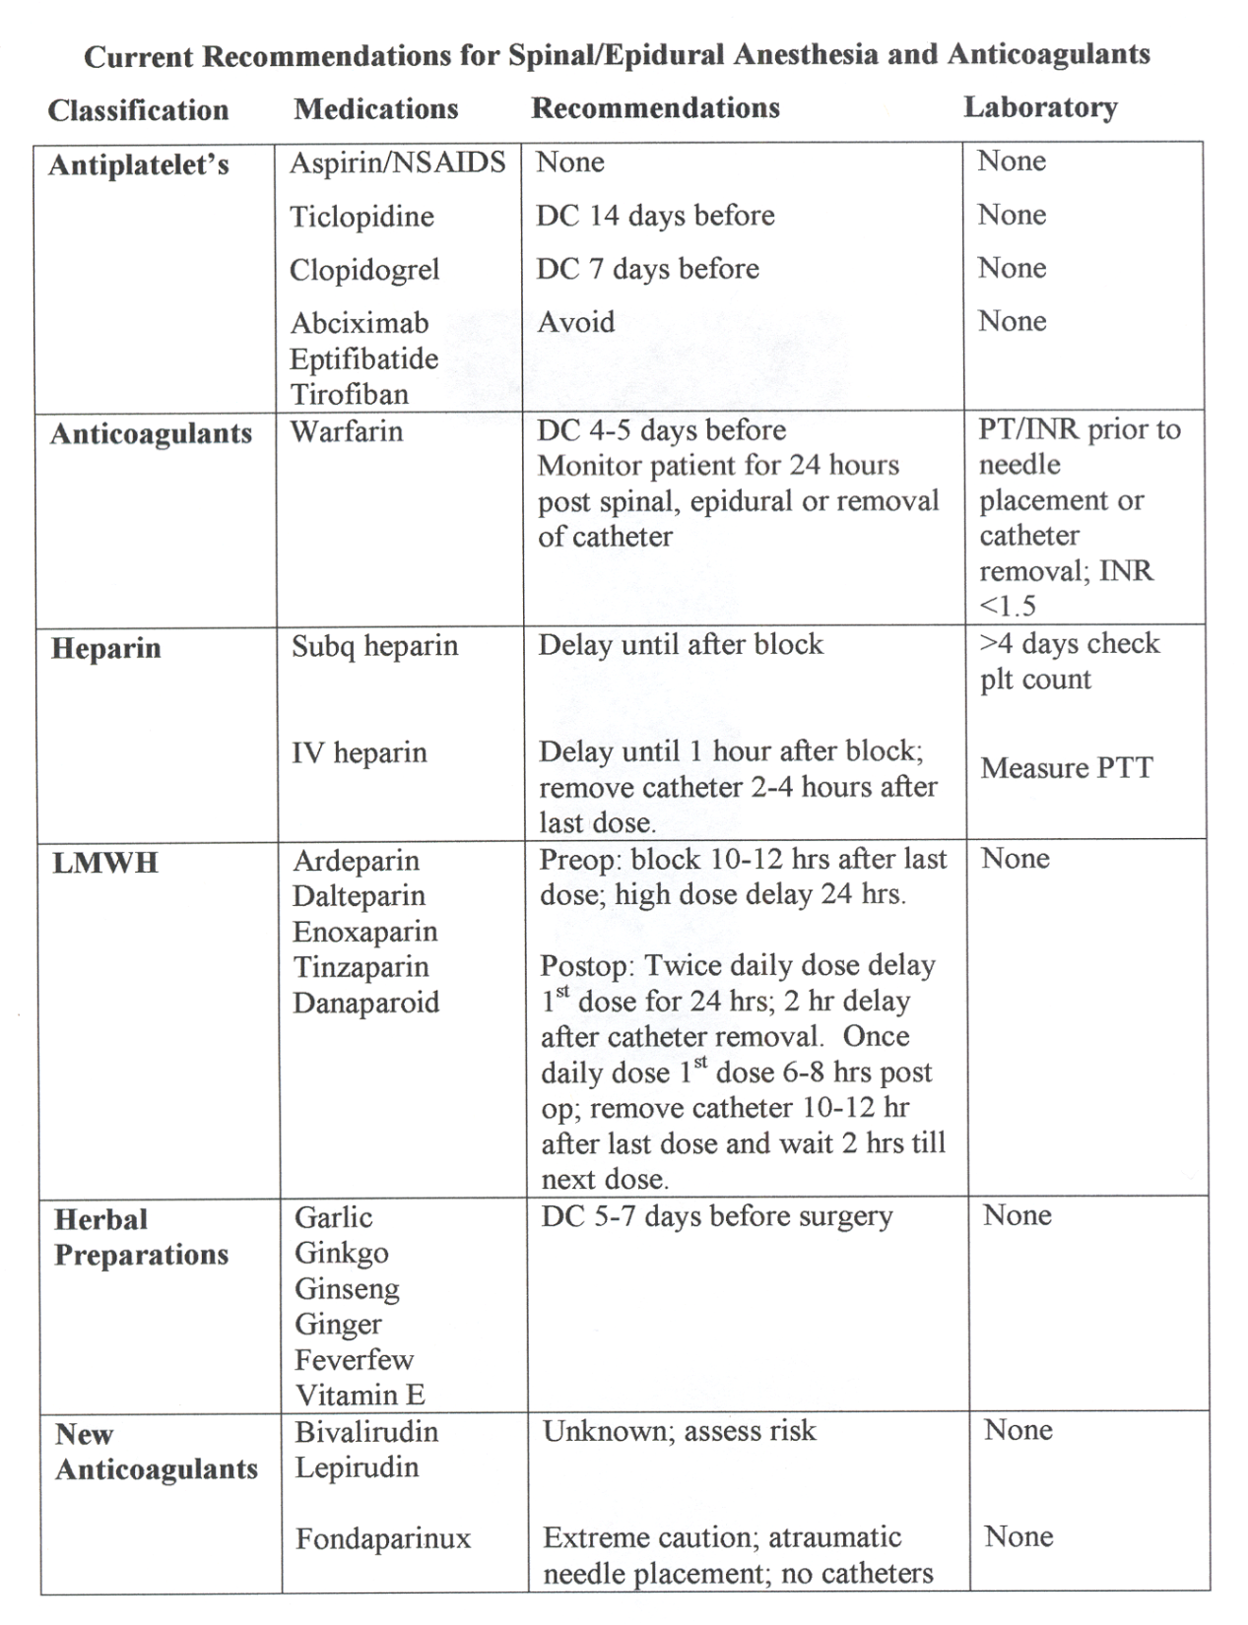

Slide 69
References
Claerhout AJ, Johnson M, Radtke JD, Zaglaniczny KL. Anticoagulation and spinal and epidural anesthesia. AANA Journal. 2004;72: 225-231.
Horlocker TT, Wedel DJ, Benzon H, et al. Regional anesthesia in the anticoagulated patient: defining the risks (The second ASRA Consensus conference on neuraxial anesthesia and anticoagulation). Reg Anesth Pain Med. 2003;28:172-197.
2nd Consensus Conference on Neuraxial Anesthesia and Anticoagulation. April 25-28th, 2002. Accessed at http://asra.com/Consensus_Conferences/Consensus_Statements.shtml
Kleinman W. Spinal, epidural, and caudal blocks. In Morgan G, Mikhail MS, Murrey MJ, Larson CP. Clinical Anesthesiology 3rd Edition. Lange Medical Books, New York. 2002; 279-280.

