Slide 1
Indications and Contraindications for Regional Anesthesia
Soli Deo Gloria
Lecture 3
Developing Countries Regional Anesthesia Lecture Series
Daniel D. Moos CRNA, Ed.D. USA moosd@charter.net

Slide 2
Disclaimer
Every effort was made to ensure that material and information contained in this presentation are correct and up-to-date. The author can not accept liability/responsibility from errors that may occur from the use of this information. It is up to each clinician to ensure that they provide safe anesthetic care to their patients.

Slide 3
General Considerations
Suitability for the type of surgery being performed
Surgeon’s preference
Experience in performing the block
Physiological/mental state of the patient

Slide 4
Generic Advantages of Peripheral Nerve Blocks
Improved patient satisfaction
Less immunosuppression
Less nausea and vomiting
Non-general anesthetic option for patient with malignant hyperthermia
Patient who is hemodynamically unstable or too ill to tolerate a general anesthetic

Slide 5
Generic Risks for Peripheral Nerve Block
Toxicity of local anesthetics
Transient or chronic paresthesia
Nerve damage
Intra-arterial injection (seizures/cardiac arrest)
Block failure (need to supplement or induce general anesthesia)

Slide 6
Contraindications to Peripheral Nerve Block
Pediatric patients, combative patients, demented patients
Bleeding disorders
Sepsis
Local anesthetic toxicity risk
Pre-existing peripheral nerve neuropathies

Slide 7
Indications for Neuraxial Blockade
In addition to some of the peripheral nerve block indications…
Patient mentally prepared to accept neuraxial blockade
No contraindications
No need for routine labs unless meds or conditions dictate this

Slide 8
Absolute Contraindications for Neuraxial Blockade
Patient refusal
Infection at the site of injection
Coagulopathy
Severe hypovolemia
Increased Intracranial pressure
Severe Aortic Stenosis
Severe Mitral Stenosis
Ischemic Hypertrophic Sub-aortic Stenosis

Slide 9
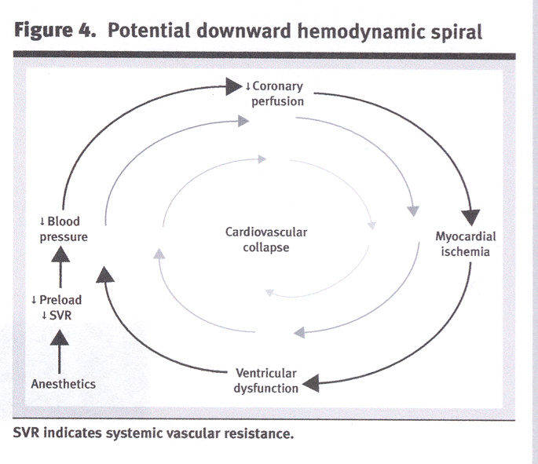
Risk of Neuraxial Blockade with Aortic Stenosis/Ischemic Hypertrophic Sub-aortic Stenosis
Phillips D. Aortic Stenosis: A Review. AANA Journal, 74:4: 2006

Slide 10
Severe Mitral Stenosis
Must avoid tachycardia. Tachycardia impairs ventricular filling, increases valvular gradient, exacerbates pulmonary congestion/hypertension.
An abrupt decline in systemic vascular resistance may result in hypotension and reflex tachycardia.

Slide 11
Relative Contraindications
Sepsis
Uncooperative patients
Pre-existing neuro deficits/neurological deficits
Demylenating lesions
Stenotic valuvular heart lesions (mild to moderate Aortic Stenosis/Ischemic Hypertrophic Sub-aortic Stenosis)
Severe spinal deformities

Slide 12
Controversial
Prior back surgery
Inability to communicate with the patient
Complicated surgeries that may involved prolonged periods of time to perform, major blood loss, maneuvers that may complicate respiration

Slide 13
Neuraxial anesthesia & pre-existing central nervous system disorders: Re-evaluating what we have been taught.

Slide 14
Neuraxial anesthesia and pre-existing CNS disorders
Taught in the past that (Vandam & Dripps in 1956) to avoid spinal anesthesia in patients that have pre-existing CNS disorders.
JR Hebel, TT Horlocker, DR Schroeder. Neuraxial anesthesia and analgesia in patients with preexisting central nervous system disorders. Anesthesia & Analgesia. 223-228. 103(1), 2006.

Slide 15
Theoretical Reasons
Mechanical trauma from needles/catheters
Local anesthetic toxicity
Neural toxicity (i.e. epinephrine)
Chronic neural compromise
JR Hebel, TT Horlocker, DR Schroeder. Neuraxial anesthesia and analgesia in patients with preexisting central nervous system disorders. Anesthesia & Analgesia. 223-228. 103(1), 2006.

Slide 16
It is not as simple as that! It is difficult to “isolate” regional anesthesia as the cause of changes in the neurological status.

Slide 17
Contributing factors to deterioration in pre-existing neurological status
Extremes of age/body habitus
Surgical trauma
Tourniquet inflation pressures/length of time for inflation
Prolonged/difficult labor or normal vaginal delivery can result in a host of neurological deficits.
Improper patient positioning
Anesthetic technique
Some diseases such as Multiple Sclerosis may become worse during the perioperative period.
JR Hebel, TT Horlocker, DR Schroeder. Neuraxial anesthesia and analgesia in patients with preexisting central nervous system disorders. Anesthesia & Analgesia. 223-228. 103(1), 2006.

Slide 18
The Study
Retrospective study of 139 patients with confirmed pre-existing CNS disorders that included: multiple sclerosis, amyotrophic lateral sclerosis, or post polio syndrome.
All patients had either neuraxial anesthesia or analgesia. 58 patients received epidural anesthesia and 81 received spinal anesthesia
JR Hebel, TT Horlocker, DR Schroeder. Neuraxial anesthesia and analgesia in patients with preexisting central nervous system disorders. Anesthesia & Analgesia. 223-228. 103(1), 2006.

Slide 19
The Study
Of the 139 patients there were no reports of new or progressive developments in their disease, even though 74% of the patients reported active neurological symptoms.
The addition of epinephrine to local anesthetic in 52% of the patients did not cause new or progressive symptoms
JR Hebel, TT Horlocker, DR Schroeder. Neuraxial anesthesia and analgesia in patients with preexisting central nervous system disorders. Anesthesia & Analgesia. 223-228. 103(1), 2006.

Slide 20
Take Home Message
No definitive conclusion can be made regarding the safety of neuraxial blockade in patients with MS, ALS, PPS.
Suggests that the belief that these conditions are absolute contraindications should be re-evaluated.
Need further study…preferably prospective studies.
JR Hebel, TT Horlocker, DR Schroeder. Neuraxial anesthesia and analgesia in patients with preexisting central nervous system disorders. Anesthesia & Analgesia. 223-228. 103(1), 2006.

Slide 21
References
Kleinman, W. & Mikhail, M. (2006). Spinal, epidural, & caudal blocks. In G.E. Morgan et al Clinical Anesthesiology, 4th edition. New York: Lange Medical Books.
Morgan, G.E., Mikhail, M.S., Murray, M.J. (2006). Peripheral nerve blocks. In G.E. Morgan et al Clinical Anesthesiology, 4th edition. New York: Lange Medical Books.
Warren, D.T. & Liu, S.S. (2008). Neuraxial anesthesia. In D.E. Longnecker et al (eds) Anesthesiology. New York: McGraw-Hill Medical.

