Slide 1
Infiltration and Topical Anesthesia
S oli Deo Gloria
Lecture 2
Developing Countries Regional Anesthesia Lecture Series
Daniel D. Moos CRNA, Ed.D. U.S.A. moosd@charter.net

Slide 2
Disclaimer
Every effort was made to ensure that material and information contained in this presentation are correct and up-to-date. The author can not accept liability/responsibility from errors that may occur from the use of this information. It is up to each clinician to ensure that they provide safe anesthetic care to their patients.

Slide 3
Infiltration Anesthesia/Analgesia
Need to know maximum doses for the surgeon
Need to know maximum doses if we need to supplement a block
Need to know maximum dose plain and with epinephrine

Slide 4
Infiltration Anesthesia/Analgesia
Most local anesthetics can be used for infiltration anesthesia
Immediate onset for intradermal or subcutaneous administration
Epinephrine will prolong duration of action of all local anesthetics
Pain with injection is noted due to the acidic nature of local anesthetic solutions

Slide 5
Maximum Dose Plain Amides
Local Anesthetic | Concentration in % | Maximum Dose Total | Maximum Dose mg/kg | Duration of Action
Lidocaine | 0.5-1 | 300 | 4.5 | 30-60 minutes Moderate duration
Mepivacaine | 0.5-1 | 300 | 4.5 | 45-90 minutes Moderate duration
Bupivacaine | 0.25-0.5 | 175 | 2.5 | 120-240 minutes Long duration
Ropivacaine | 0.1-2 | 200 | 3 | 120-360 minutes Long duration
Note: there is a total maximum dose regardless of weight as well as a mg/kg dose.

Slide 6
Maximum Dose with Epinephrine Amides
Local Anesthetic | Concentration in % | Maximum Dose Total | Maximum Dose mg/kg | Duration of Action
Lidocaine | 0.5-1 | 500 | 7 | 120-360 minutes Moderate duration
Mepivacaine | 0.5-1 | 500 | 7 | 120-360 minutes Moderate duration
Bupivacaine | 0.25-0.5 | 225 | 3 | 180-420 minutes Long duration
Note: there is a total maximum dose regardless of weight as well as a mg/kg dose.

Slide 7
Maximum Doses- Where is the evidence?
Maximum doses are based on manufacturer recommendations, animal studies, and case reports.
Maximum doses vary by country.
Rosenberg et. al. (2004). Maximum recommended doses of local anesthetics: a multifactoral concept. Regional Anesthesia, 29, 564-575.

Slide 8
Maximum doses by country
Local Anesthetic | Finland | Sweden | United States
Bupivacaine plain | 175 mg | 150 mg | 175 mg
Lidocaine plain | 200 mg | 200 mg | 300 mg
Mepivacaine with epinephrine | None listed | 350 mg | 550 mg
Ropivacaine | 225 mg | 200 mg | 225 mg
Adopted from Rosenberg et. al., 2004

Slide 9
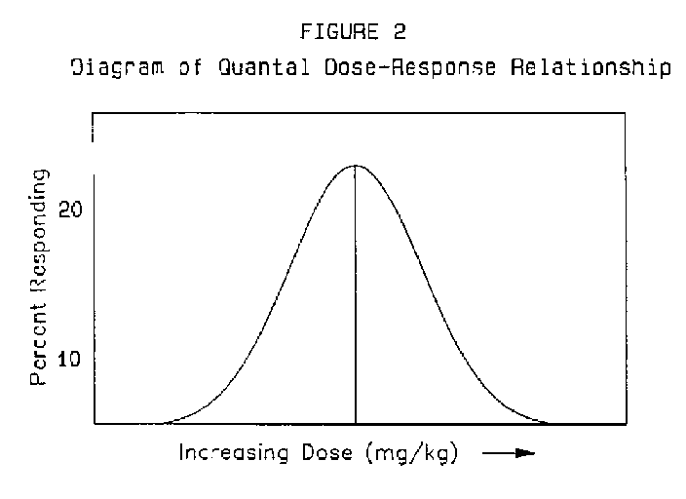
Maximum Doses- Where is the evidence?
Animal studies are used to identify quantal dose-effect curves to determine median effective doses (ED50) and median toxic dose (TD50).

Slide 10
Maximum Doses- Where is the evidence?
Therapeutic index is derived as a ratio of TD50 and ED50.
Problem with animal studies is they do not accurately replicate the complexities found within human populations.
Rosenberg et. al. (2004). Maximum recommended doses of local anesthetics: a multifactoral concept. Regional Anesthesia, 29, 564-575.

Slide 11
Maximum Doses- Where is the evidence?
What impacts toxic doses of local anesthetics and subsequent plasma concentrations?
  Site of administration- direct impact as noted earlier.
  Use of vasoconstrictors- decreases absorption but is dependent upon specific local anesthetic used and site of administration.
  Disease processes- directly impact plasma concentrations of local anesthetics.
Rosenberg et. al. (2004). Maximum recommended doses of local anesthetics: a multifactoral concept. Regional Anesthesia, 29, 564-575.

Slide 12
Example of hyperdynamic circulations impact on local anesthetics…i.e. uremia/pregnancy
Hyperdynamic Circulation
Enhanced local uptake of local anesthetic
Peak concentrations occur earlier and result in higher concentrations of local anesthetics
Rosenberg et. al. (2004). Maximum recommended doses of local anesthetics: a multifactoral concept. Regional Anesthesia, 29, 564-575.

Slide 13
Maximum Doses- Where is the evidence?
Based on these observations maximum dose recommendations have been called into question.
Attempts are being made to create recommendations based on age, renal, hepatic, cardiac diseases, and pregnancy.
Poor quality of data (case series, cohort studies) have hindered creating specific recommendations at this time.
Rosenberg et. al. (2004). Maximum recommended doses of local anesthetics: a multifactoral concept. Regional Anesthesia, 29, 564-575.

Slide 14
Maximum Doses- Where is the evidence?
Until better evidence is available the anesthesia provider should ‘stick’ with current recommendations.

Slide 15
Topical Anesthesia

Slide 16
Topical Anesthesia
Lidocaine
Dibucaine
Tetracaine
Benzocaine
EMLA

Slide 17
Topical Anesthesia
Effective, short term analgesia
Applied to mucous membranes, intact skin, and abraded skin

Slide 18
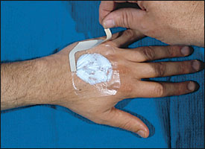
EMLA Cream

Slide 19
EMLA
Mixture of 2.5% lidocaine and 2.5% prilocaine
Risk of methemoglobinemia is rare
Safe in neonates
Effective in anesthetizing the skin for cannulation and skin grafts
Must be applied under an occlusive dressing for 45-60 minutes

Slide 20
TAC
0.5% tetracaine
1:200,000 epinephrine
10-11.8% cocaine

Slide 21
TAC
Safe on skin
Not safe on mucous membranes due to rapid absorption and risk of toxicity
Max dose for adults is 3-4 ml
Max dose peds is 0.05 ml/kg
Concern about the cocaine component

Slide 22
LET
Lidocaine
Epinephrine
Tetracaine

Slide 23
LET
Alternative to TAC (no cocaine)
More dilute preparations in peds

Slide 24
Addition of Phenylephrine or Oxymetazoline
Large amounts of phenylephrine on mucous membranes can lead to HTN and reflex bradycardia
Oxymetazoline has a larger safety of margin

Slide 25
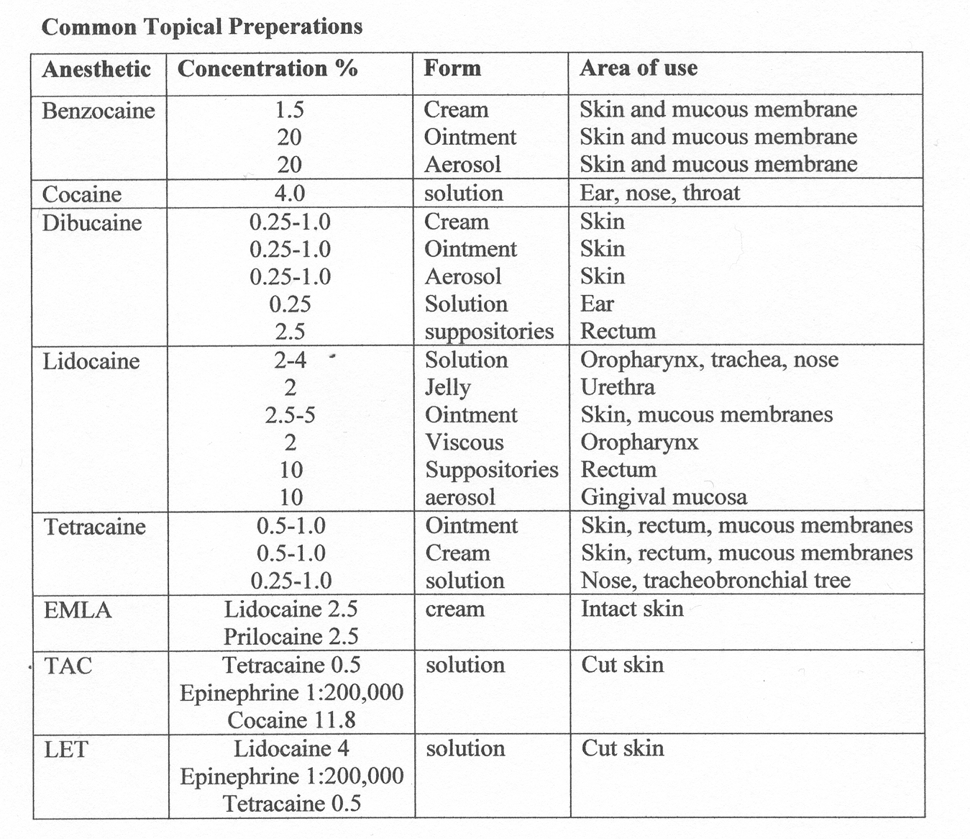

Slide 26
Methemoglobinemia & Benzocaine
Benzocaine application can result in the potentially fatal complication of methemoglobinemia (MHb)
As an anesthesia provider you may called to assist in airway management in another department (i.e. endoscopy, CV with TEE)
As an anesthesia provider you may encounter this complication when applying local anesthetic to mucous membranes in preparation to perform a fiberoptic intubation
Recognition of this complication is important

Slide 27
Methemoglobinemia & Benzocaine
Benzocaine is the most commonly implicated local anesthetic in the development of MHb.
Incidence: 1:7,000 exposures
Up to 35% of benzocaine that is applied to mucous membranes is absorbed systemically.

Slide 28
Problems with Benzocaine Application
Hard to estimate the dose that is actually administered
Application should be for 1 second or less
46.4% of the cases of MHb associated with benzocaine reported to the FDA had more than 1 spray administered or longer than 1 second spray.

Slide 29
MHb brief pathophysiology
Hemoglobin contains 4 heme groups (Fe+2) on the surface of the molecule.
MHb is a form of hemoglobin that is unable to bind with O2
Benzocaine can oxidize Fe+2 to Fe+3.
Since MHb is unable to bind with O2 there is a diminished ability to deliver O2 to tissue.

Slide 30
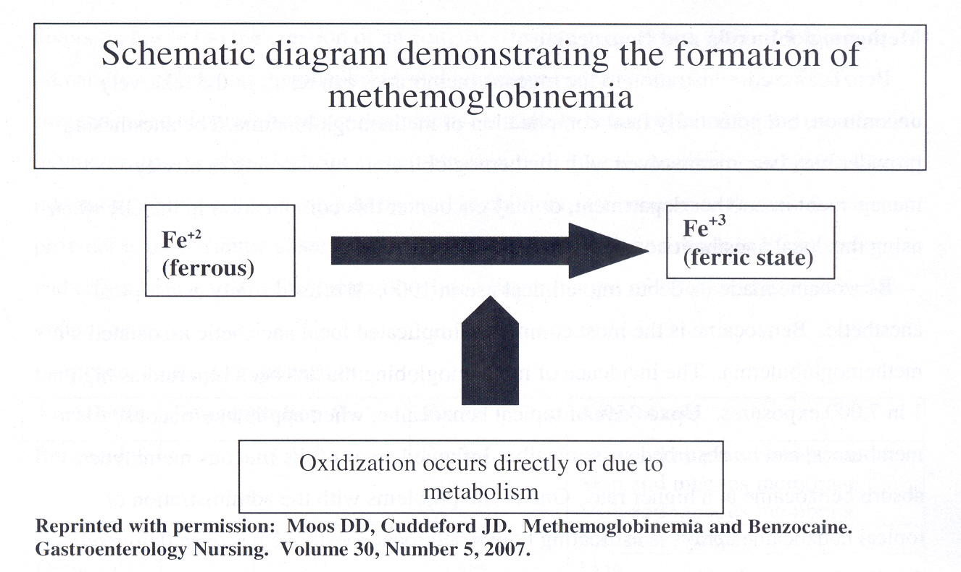

Slide 31
Signs and Symptoms of MHb are Dependent Upon the Levels of MHb
Patients with anemia and CV disease may demonstrate S+S earlier
10% MHb cyanosis
15% MHb cyanosis, headache, weakness, dizziness, lethargy, & tachycardia
10-20% levels are generally well tolerated
45% dyspnea, cyanosis, seizures, coma, dysrhymias, & heart failure
70% mortality can occur

Slide 32
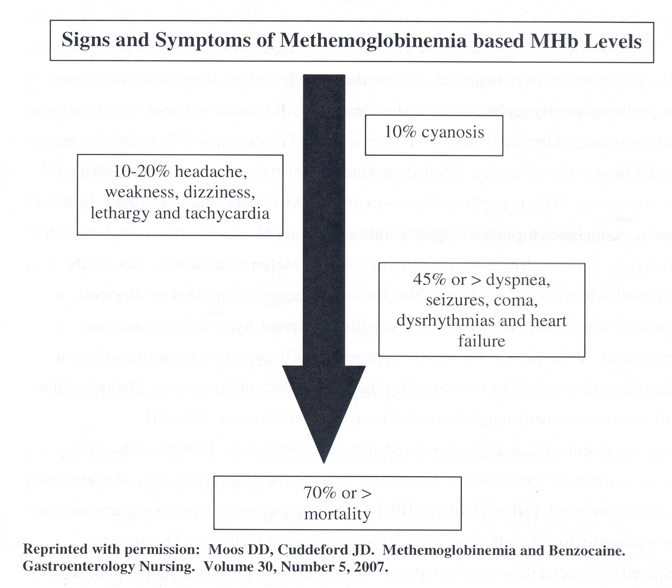

Slide 33
MHb Diagnosis
Suspected in any patient that develops cyanosis after the administration of topical pharyngeal anesthesia in which supplemental oxygen does not improve the patients symptoms.
SA02 is inaccurate, reading may range from 80-85% regardless of what the MHb % content is. Inaccuracies occur when the MHb level is > 10%

Slide 34
MHb Diagnosis
Co-oximetry is able to dx the levels of MHb. This is the gold standard for dx and is available with most ABG determinations (but not all)
Request it when sending the lab sample

Slide 35
MHb Treatment
Must first confirm presence of MHb
Methylene blue 1-2 mg/kg IVP over 5 minutes
Methylene blue accelerates the capacity of NADPH MHb reductase to reduce MHb to normal hemoglobin
Side effects of methylene blue include dizziness, confusion, restlessness, headache, abdominal pain, nausea and vomiting, dyspnea, hyper or hypotension, & diaphoresis.

Slide 36
MHb Treatment
Methylene blue will not help in patients with G-6 deficiency, NADPH Mhb, cytochrome b5 reductase deficiency. It should be avoided in these patients.
If the patients condition improves then the patient needs to monitored for reoccurrence.
A 2nd dose can be administered in 1 hour. Total dose should not exceed 7 mg/kg since methylene blue can result in the formation of MHb

Slide 37
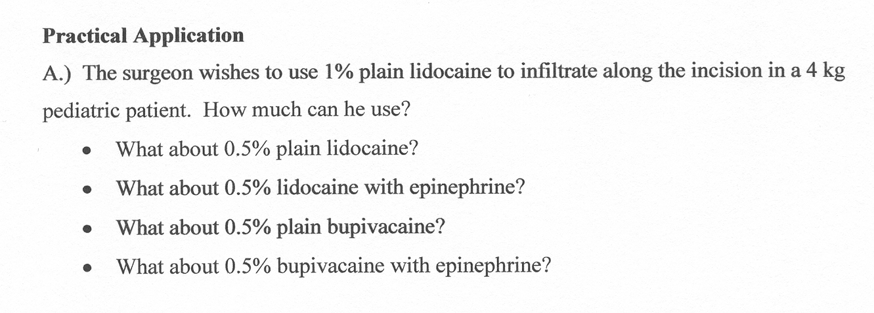
Practical Applications

Slide 38
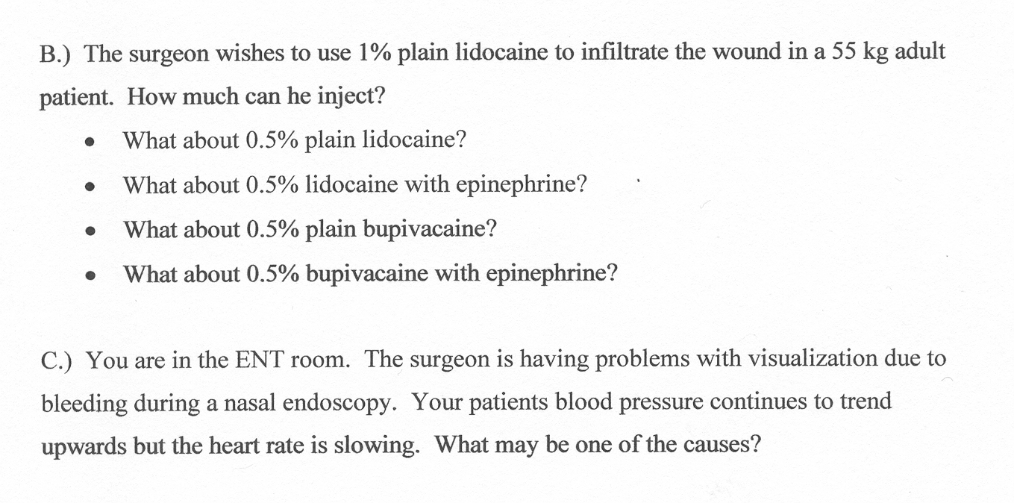
Practical Applications

Slide 39
References
Bourne, H.R. & Roberts, J.M. (1992). Drug Receptors & Pharmacodynamics. In B.G. Katzung (editor) Basic & Clinical Pharmacology. Norwalk, Connecticut: Appleton & Lange.
Heavner, J.E. (2008). Pharmacology of local anesthetics. In D.E. Longnecker et al (eds) Anesthesiology. New York: McGraw-Hill Medical.
Moos, D.D. & Cuddeford, J.D. (2007). Methemoglobinemia and benzocaine. Gastroenterology Nursing, 30, 342-345.
Morgan, G.E., Mikhail, M.S., Murray, M.J. (2006). Local anesthetics. In G.E. Morgan et al Clinical Anesthesiology, 4th edition. New York: Lange Medical Books.
Rosenberg, P.H., Veering, B.Th., Urmey, W.F. (2004). Maximum recommended doses of local anesthetics: a multifactorial concept. Regional Anesthesia, 29, 564-575.
Strichartz, G.R. & Berde, C.B. (2005). Local Anesthetics. In R.D. Miller Miller’s Anesthesia, 6th edition. Philadelphia: Elsevier Churchill Livingstone.
Wedel, D.J. & Horlocker, T.T. (2008). Peripheral Nerve Blocks. In D.E. Longnecker et al (eds) Anesthesiology. New York: McGraw-Hill Medical.

