Slide 1
LOCAL ANESTHETIC REVIEW
Soli Deo Gloria
Developing Countries Regional Anesthesia Lecture Series
Daniel D. Moos CRNA, Ed.D. USA moosd@charter.net
Lecture 1

Slide 2
Disclaimer
Every effort was made to ensure that material and information contained in this presentation are correct and up-to-date. The author can not accept liability/responsibility from errors that may occur from the use of this information. It is up to each clinician to ensure that they provide safe anesthetic care to their patients.

Slide 3
A Brief History of Local Anesthetics
Pre-Columbian natives of Peru chew coca leaves. Decreased fatigue and promoted a feeling of well being.
1884 Koller introduces cocaine into clinical practice by utilizing it as a topical anesthetic for the cornea. Problem…physical dependence and toxicity.

Slide 4
A Brief History of Local Anesthetics
1905 Einhorn introduces the prototypical ester local anesthetic procaine.
1943 Lofgren introduces the prototypical amide local anesthetic lidocaine.

Slide 5
Chemistry of Local Anesthetics

Slide 6
Local Anesthetics Consist of 3 Parts
Lipophilic (Hydrophobic) Group- aromatic group that is usually an unsaturated benzene ring.
Intermediate Bond- hydrocarbon connecting chain that is either an ester
(-CO-) or amide (-HNC-) linkage.
Hydrophilic (Lipophobic) Group- usually a tertiary amine and proton acceptor.

Slide 7
Local Anesthetic Molecule “parts”
N
Lipophilic Group Intermediate Bond Hydrophilic Group
Benzene Ring Ester or Amide Linkage Tertiary Amine &
(-CO- ester or –HNC- amide) Proton Acceptor
Notes:
al;l;'jl;af'l;jfajad'l;fj

Slide 8
The difference between an ester and amide local anesthetic
Ester’s and amides follow different pathways for metabolism.
Ester’s and amides differ in their ability to produce allergic reactions. (Ester’s are more prone to cause an allergic reaction).

Slide 9
Telling the difference between an ester and amide (besides the chemical structure)
Amides will contain an “i” in the generic name prior to “-caine”. (i.e. lidocaine, mepivacaine, prilocaine, bupivacaine, ropivacaine, and levo-bupivacaine).
Ester’s do not contain an “i” in the generic name prior to “-caine”. (i.e. procaine, chloroprocaine, cocaine, benzocaine, and tetracaine).

Slide 10
Amides and Esters
Amides | Esters
Bupivacaine | Benzocaine
Etidocaine | Chloroprocaine
Levobupivacaine | Cocaine
Lidocaine | Procaine
Mepivacaine | Tetracaine
Prilocaine
Ropivacaine

Slide 11
Stereoisomerism
Many medications contain chiral molecules and exist as stereoisomers.
Chiral compound contains a center carbon atom with four other compounds attached to it.
Stereoisomers are classified as optical, geometric, and confirmational.

Slide 12
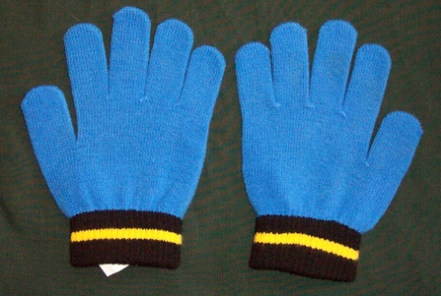
Stereoisomerism
Optical isomers (enantiomers) are mirror images of each other. Though mirror images that can not be superimposed on each other.

Slide 13
Stereoisomerism
Each enantiomer may have a different physiological effect.

Slide 14
Effects of Enantiomer’s
R
Each may exert differences in:
Absorption
Distribution
Potency
Toxicity
Therapeutic Action
S
Enantiomer - R
Enantiomer - S

Slide 15
Racemic Mixtures
Up to 1/3rd of all medications contain stereoisomers.
Racemic Mixtures contain two isomers in equal concentrations (i.e. racemic epinephrine).
Bupivacaine is a racemic mixture (R-bupivacaine and S- bupivacaine).
In effect the administration of a racemic preparation is to administer two different medications.

Slide 16
Receptors are stereospecific (allow only one stereoisomer to attach) and stereoselective (prefer one isomer over the other).
One enantiomer will exhibit a greater potency, safety profile, and reduced side effects.
Bupivacaine is a racemic preparation with significant toxicity issues. S- bupivacaine is almost as potent as the racemic preparation but less toxic.

Slide 17
Ropivacaine is a pure isomer (S-ropivacaine).

Slide 18
Structure Activity Relationship

Slide 19
Intrinsic Potency, Duration of Action, and Onset is Dependent on:
Lipophilic-Hydrophobic Balance
Hydrogen Ion Concentration

Slide 20
Lipophilic-Hydrophobic Balance
Lipophilic means “fat” loving and expresses the tendency of local anesthetic molecules to bind with membrane lipids.
Hydrophobic means “fear” of water
Hydrophobicity is a term that describes the physiochemical property of local anesthetics and is associated with potency.

Slide 21
Lipophilic-Hydrophobic Balance
Lipid membrane is a hydrophobic environment.
Membranes that are more hydrophobic (lipophilic) are more potent and produce a longer block.

Slide 22
Lipophilic-Hydrophobic Balance- Potency
Potency (lipid solubility) is increased by increasing the total number of carbon atoms.
Etidocaine has 3 more carbon atoms than lidocaine. Thus etidocaine is 4 times more potent and 5 times longer acting than lidocaine.
Works well in the lab but…

Slide 23
As with most things in life it gets a bit more complicated than that. In the clinical setting there are many factors that influence the potency of local anesthetics.

Slide 24
Factors that affect potency of local anesthetics
Hydrophobicity (lipid solubility)
Hydrogen ion balance
Vasoconstrictor/vasodilator properties (affects the rate of vascular uptake)
Fiber size, type, and myelination
Frequency of nerve stimulation
pH (acidic environment will antagonize the block)
Electrolyte concentrations (hypokalemia and hypercalcemia antagonizes blockade).
We will cover each in more detail shortly……

Slide 25
Despite the differences between the laboratory setting and the clinical factors that can affect potency there is still a correlation between lipid solubility, potency, and duration of action.

Slide 26
Lipophilic-Hydrophobic Balance-Duration of Action
Highly lipid soluble local anesthetics generally have a longer duration of action.
This is due to a higher degree of protein binding and decreased clearance by local blood flow.

Slide 27
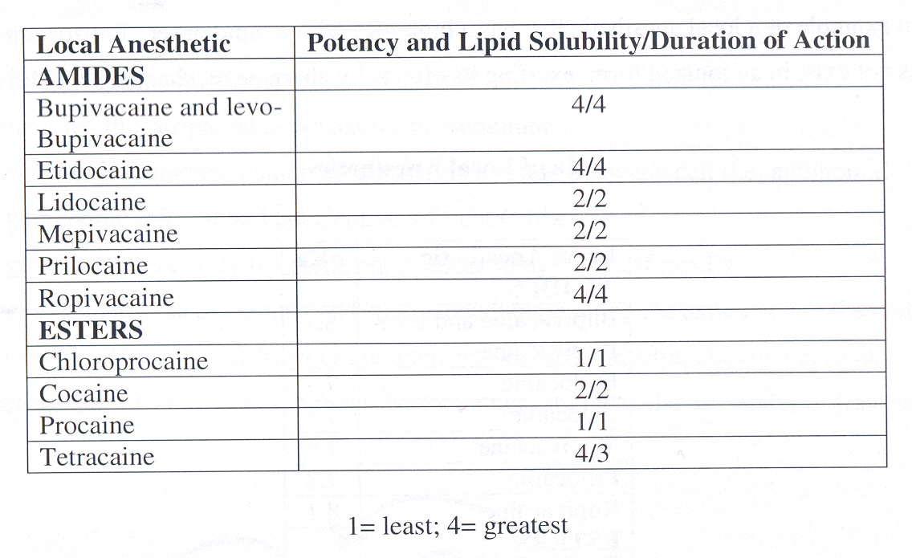
Lipophilic-Hydrophobic Balance- Potency and Lipid Solubility/Duration of Action
1 = Least
4 = Greatest
Note the correlation between potency/lipid solubility and the duration of action.

Slide 28
Hydrogen Ion Concentration

Slide 29
Hydrogen Ion Concentration
Local anesthetics exist as a weak base
Local anesthetics in solution exist in equilibrium between basic uncharged (non-ionized) form (B), which is lipid soluble.
And a charged (ionized) form (BH+), which is water soluble.

Slide 30
pKa
pKa expresses the relationship between ionized and non-ionized forms of local anesthetic.
pKa is the pH at which the ionized and non-ionized forms are equal.

Slide 31
pKa
Non-Ionized Form Ionized Form
pKa= pH at which ionized and non-ionized forms of local anesthetics are equal.

Slide 32
pKa
In general when the pKa approximates the physiological pH there will be a higher concentration of non-ionized base and a faster onset.

Slide 33
Ionized vs Non-ionized forms
Each form has its own specific mechanism of action.
Non-ionized (lipid soluble) penetrates the neural sheath and passes on to the nerve membrane.
Within the cell equilibrium will occur between non-ionized and ionized forms.
Ionized (water soluble) form is responsible for binding to the sodium channels.
During each phase of distribution within the tissue, equilibration occurs between the non-ionized and ionized forms.

Slide 34
Ionized vs Non-ionized forms
Non-ionized penetrates the neural sheath/membrane
Ionized
Lipid Layer

Slide 35
Ionized vs Non-ionized forms
Ionized- Binds with the sodium channel
Ionized form of local anesthetic molecule
Na+ Channel

Slide 36
Ionized vs Non-ionized Forms
Clinical onset is not the same for all local anesthetics with the same pKa!
This may be due to the individual local anesthetics ability to diffuse through connective tissue.
Generally, the closer the pKa to physiological pH the faster onset with exceptions (i.e. chloroprocaine and benzocaine.)

Slide 37
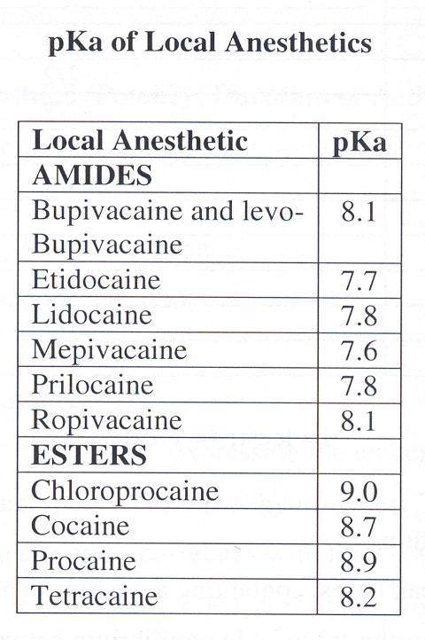
pKa of Local Anesthetics

Slide 38
Clinical Implications of Ionized and Non-ionized Forms of Local Anesthetic
Local anesthetics are prepared in a water soluble HCL salt with a pH of 6-7.
If epinephrine is added, in a commercial preparation, the pH is kept between 4-5 to keep epinephrine stable. This creates less free base (non-ionized) and slows the onset of action.

Slide 39
Clinical Implications of Commercial Solutions
Some clinicians will add NaBicarb to commercially prepared solutions that contain epinephrine to increase the amount of free base (non-ionized form).
1 ml of 8.4% NaBicarb to each 10 ml of lidocaine or mepivacaine or 0.1 ml of 8.4% NaBicarb to each 10 ml of bupivacaine.
If you add more NaBicarb than suggested the solution will precipitate.

Slide 40
Reported Benefits of adding Sodium Bicarbonate
Increases the amount of free base (non-ionized form of local anesthetic)
Speed onset
Improve quality of the block
Prolongs the duration of blockade
Decreased pain associated with subcutaneous infiltration

Slide 41
Peripheral Nerve Anatomy

Slide 42
Peripheral Nerve Anatomy
Axolemma- peripheral nerve axon cell membrane.
Non-myelinated nerves contain axons within a single Schwann cell.
Large motor and sensory fibers are enclosed in many layers of myelin

Slide 43
Peripheral Nerve Anatomy
Myelin- insulates and speeds the conduction along the axolemma to the nodes of Ranvier.
Nodes of Ranvier- interruptions in the myelin that allow for regeneration of the current (high concentrations of Na+ channels are found here).

Slide 44
Local Circuit Current Node of Ranvier

Slide 45
Peripheral Nerve Anatomy
Non-myelinated nerve fibers have Na+ channels distributed all along the axon.

Slide 46
Local Circuit Current
Non-myelinated Fiber

Slide 47
Peripheral Nerve Anatomy
Fascicles- several axon bundles.
Endoneurium- connective tissue that surrounds and individual nerve.
Perineurium- connective tissue that surrounds each fascicle.
Epineurium- connective tissue that covers the entire nerve.

Slide 48
Transverse Section of a Peripheral Nerve
Endoneurium- connective tissue that surrounds and individual nerve.
Perineurium- connective tissue that surrounds each fascicle.
Epineurium- connective tissue that covers the entire nerve.
Endoneurium
Epineurium
Perineurium

Slide 49
Nerve Conduction Physiology

Slide 50
Nerve Conduction Physiology
Neural membrane voltage difference +60 mV (inner) to -90 mV (outer).
Neural membrane at rest is impermeable to Na+ ions but permeable to K+ ions.
K+ within the cell is kept at a high concentration while Na+ on the outside of the cell is high.
Gradient is kept by the Na+/K+ pump.

Slide 51
Nerve Conduction Physiology
At Rest
Outside Cell
-90 mV K+ concentration low; Na+ concentration high
Neural Membrane
+ 60 mV K+ concentration high; Na+ concentration low
Inside Cell

Slide 52
Nerve Conduction Physiology
Action potential changes the cell permeability from K+ to Na+ and the membrane potential changes from -90 mV to +60 mV.

Slide 53
Nerve Conduction Physiology
Action Potential
Outside Cell
+60 mV Na+
Neural Membrane
-90 mV K+
Inside Cell

Slide 54
Nerve Conduction Physiology
Local anesthetics work by producing a conduction block. This prevents the passage of Na+ ions through the Na+ channels.
Local anesthetics DO NOT alter resting membrane potential but instead block the propagation of a nerve impulse.

Slide 55
Nerve Conduction Physiology
Local Anesthetic
Molecule
Na+ Channel

Slide 56
Nerve Conduction Physiology
Voltage-gated sodium channels exist in 3 forms
Resting
Inactivated
Activated or open

Slide 57
Nerve Conduction Physiology
Open Inactivated Closed
(activated) (resting)
Easily blocked More difficult to block Most difficult to block

Slide 58
Nerve Conduction Physiology
Local anesthetics are stereospecific
The Na+ channel acts as a receptor
Actions of local anesthetics depend on the conformational state of the Na+ channel.

Slide 59
Nerve Conduction Physiology
Local anesthetics bind more readily with depolarization when the conformational state is “open” or “inactivated”.
In the inactivated state the local anesthetic will bind within the Na+ channel or block the external opening. This will slow the rate of depolarization and threshold potential will not be met.

Slide 60
Fiber Types
Different fiber types will show different sensitivities to local anesthetics.

Slide 61
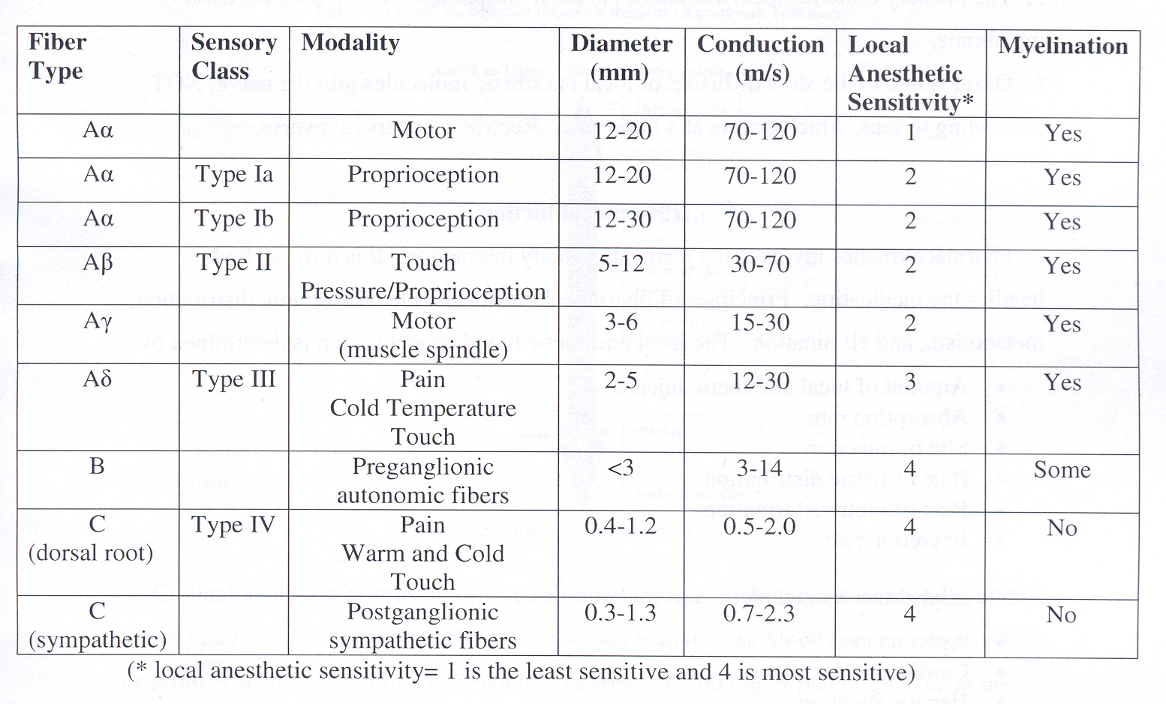
Fiber Types

Slide 62
Putting it all together
Summary of impulse blockade by local anesthetics

Slide 63
Step 1
Local anesthetic is deposited near the nerve. Some of the local anesthetic is removed due to tissue binding, circulation, and in the case of esters by local hydrolysis.
What remains is available for nerve sheath penetration.

Slide 64
Step 2
Local anesthetic penetrates the axon membranes and axoplasm- this process is dependent on the local anesthetic characteristics of pKa and lipophilicity.

Slide 65
Step 3
Local anesthetics bind to prevent the opening of the Na+ channels by inhibiting conformational changes that would activate the channel.

Slide 66
Step 4
Initially during the onset of action the onset of impulse blockade is incomplete.
Repeated stimulation helps to increase the blockade.
The primary route from within the axon is the hydrophobic route.

Slide 67
Step 5
The onset is due to the slow diffusion of local anesthetics and not due to the binding of to ions which occurs more quickly.
Recovery from local anesthetic blockade occurs in the reverse.

Slide 68
Pharmacokinetics

Slide 69
Pharmacokinetics
Involves the medication/body interaction or how the body ‘handles’ the medication.
Principles include: absorption, distribution, metabolism, and elimination.

Slide 70
Pharmacokinetic Phases of Local Anesthetics
Uptake
Site of injection
Distribution
Lipid solubility
Elimination
Metabolism
Absorption
Protein binding
Elimination

Slide 71
Local Anesthetic Blood Concentration Determinants
Amount of local anesthetic injected
Absorption rate
Site of injection
Rate of tissue distribution
Rate of biotransformation
Excretion rate

Slide 72
Patient related factors concerning blood concentration of local anesthetics
Age
CV status
Hepatic function

Slide 73
Systemic Absorption of Local Anesthetics
Site of injection
Dose and volume
Addition of a vasoconstrictor
Pharmacologic profile

Slide 74
Site of Injection
Has a great impact on the blood levels of local anesthetics. The more vascular the tissue the greater the uptake and subsequent blood concentrations.

Slide 75
Site of Injection
From the greatest amount of uptake to the least:
IV> tracheal> intercostal> caudal> paracervical> epidural> brachial> sciatic> subcutaneous

Slide 76
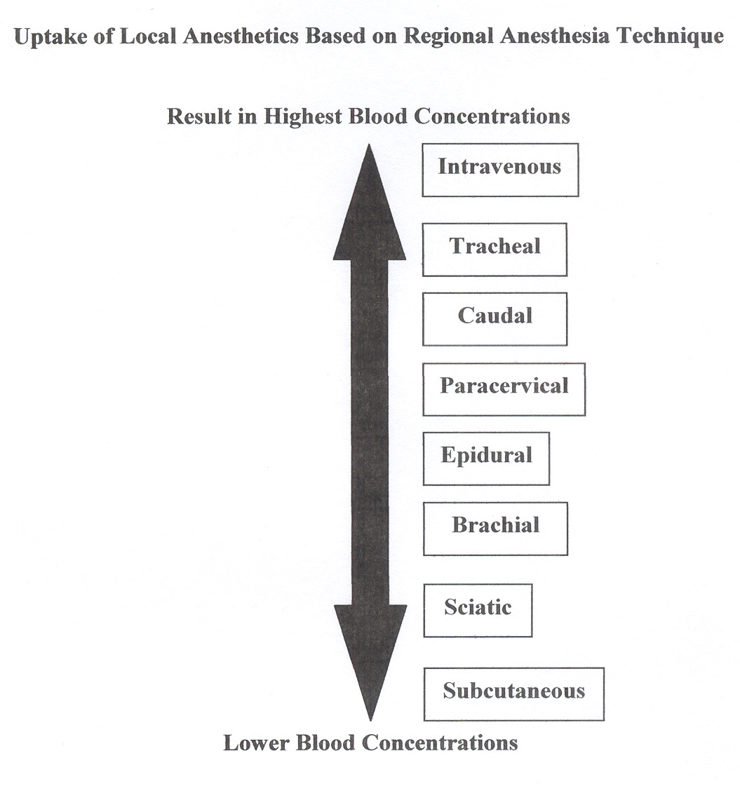

Slide 77
Mnemonics (greatest to least)
BICEPSS
B= blood/tracheal
I= intercostal
C= caudal and para “cervical”
E = epidural
P= perivascular brachial plexus
S= sciatic/spinal
S= subcutaneous

Slide 78
Site of Injection
An example of this is 400 mg of plain lidocaine in the intercostal space yields peak blood concentrations of 7 mcg/ml which may result in toxicity. 400 mg of plain lidocaine in the brachial plexus yields blood levels of 3 mcg/ml which is not generally toxic.

Slide 79
Dose and Volume
The blood concentration of a local anesthetic is proportional to the total dose of local anesthetic. (Be aware of all local anesthetic administration!)
Higher blood concentrations are associated with large volumes of dilute local anesthetic when compared to the same dose in a smaller volume. (i.e. 400 mg of lidocaine in 40 ml will result in higher blood concentrations than 400 mg of lidocaine in 20 ml)

Slide 80

Risk…Toxicity!

Slide 81
Local Anesthetic Toxicity
More later but signs and symptoms vary among local anesthetics…
With lidocaine there is a large disparity in blood concentrations between CNS signs and symptoms (which occur at lower blood concentrations and cardiovascular collapse)

Slide 82
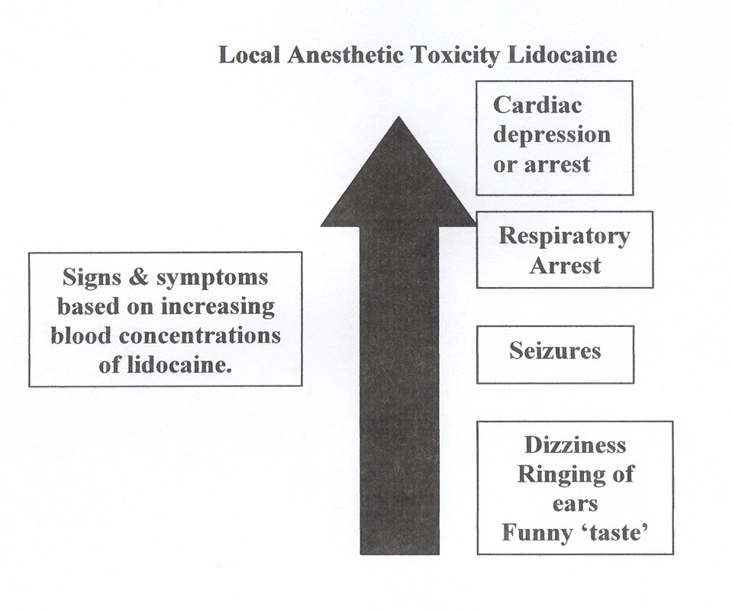

Slide 83
Local Anesthetic Toxicity
With bupivacaine there is a small disparity in blood concentrations between CNS signs and symptoms and CV collapse.
CNS signs and symptoms may occur at the same time or close together.

Slide 84
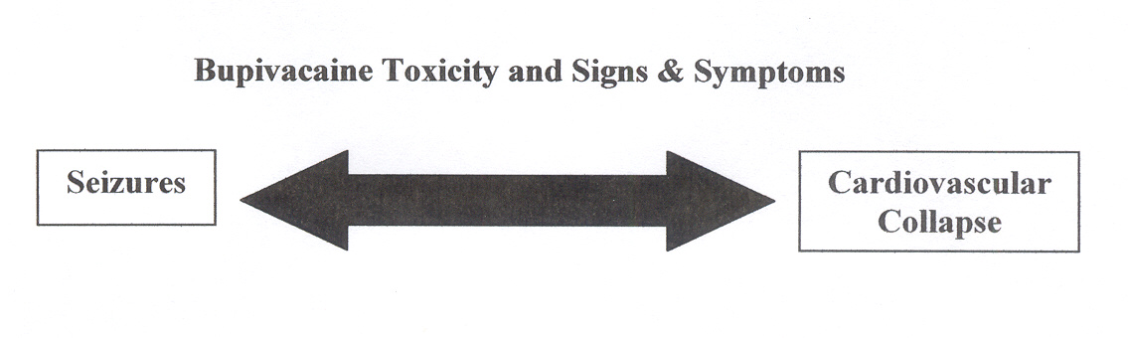

Slide 85
Local Anesthetic Toxicity
Ropivacaine is similar to bupivacaine in onset and duration. It has a better safety profile in regards to CV toxicity when compared to bupivacaine.
First pass metabolism plays a role. Amides have a high rate of first pass metabolism as it passes through the liver.
Slow absorption from tissue is less likely to produce toxicity.
Toxicity is the result of intravenous/arterial injection or gross overdose.

Slide 86
Vasoconstrictor Use
Epinephrine in doses of 5-20 mcg per ml can be used to decrease vascular absorption.
Does not work equally for all local anesthetics in all spaces.

Slide 87
Vasoconstrictor Use
5 mcg/ml of epinephrine will significantly reduce the absorption of mepivacaine and lidocaine.
Addition of epinephrine does not significantly reduce the vascular absorption of etidocaine and bupivacaine in the epidural space. However, it does significantly reduce the absorption when used for peripheral nerve blocks.

Slide 88
Benefits of Decreased Absorption
Increased neuronal uptake
Enhances quality of analgesia
Prolongs duration of action
Limits toxic side effects

Slide 89
Vasoconstrictor Use
1:200,000 or 5 mcg/ml of epinephrine is used for peripheral nerve blocks.
Clinical trick for adding epinephrine to local anesthetic in a dose of 5 mcg/ml.

Slide 90
Another Technique
1:200,000 concentration = 5 mcg/ml
Dilute epi using a 10 ml syringe. Draw up 1 ml of 1:1000 epi (1 mg/ml) and 9 ml of preservative free normal saline.
Mix it.
Concentration is now 100 mcg per ml.
Add epinephrine as follows….

Slide 91
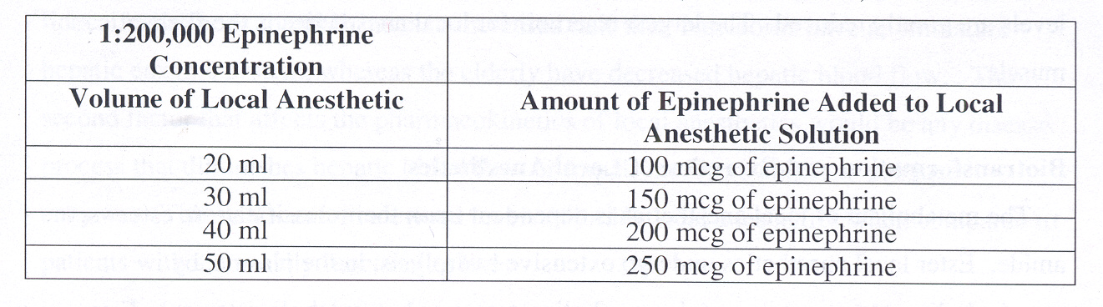

Slide 92
Always double check your epinephrine by multiplying 5 mcg per ml by the total volume.
Discard remaining epinephrine…epinephrine can be lethal if inadvertently administered.

Slide 93
Pharmacologic Profile
Individual local anesthetics with similar anesthetic profiles will exhibit different rates of absorption.
Local anesthetics that are highly bound to tissue are absorbed more slowly.
Absorption is dependant upon each local anesthetics intrinsic ability to cause vasodilatation.

Slide 94
Pharmacologic Profile
Examples of this include:
In the brachial plexus lidocaine is absorbed more rapidly than prilocaine. Bupivacaine is absorbed more rapidly than etidocaine.

Slide 95
Distribution of Local Anesthetics
2 compartment model used for systemic distribution of local anesthetics:
ﻪ phase – rapid disappearance phase related to uptake to high perfusion areas such as the brain, lung, kidney, and heart.
Β phase- slow disappearance phase which is the function of the individual local anesthetic and distribution to muscle tissue and the gut.

Slide 96
Distribution of Local Anesthetics
Local anesthetics are distributed to all body tissues.
Higher concentrations are found in the highly perfused tissue.
The pulmonary system is responsible for extraction of local anesthetics.
Largest reservoir of local anesthetics is skeletal muscles.

Slide 97
Biotransformation and Excretion of Local Anesthetics
Metabolism is dependant on classification: ester vs. amide.

Slide 98
Ester Local Anesthetics

Slide 99
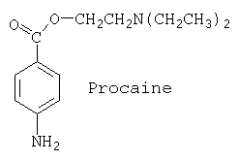
Procaine

Slide 100
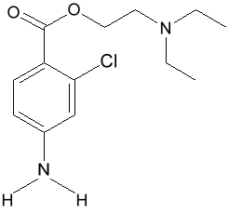
Chloroprocaine

Slide 101
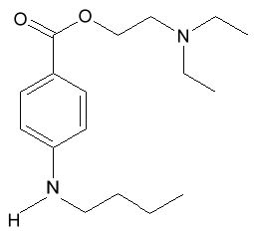
Tetracaine

Slide 102
Biotransformation and Excretion of Ester Local Anesthetics
Extensive hydrolysis in the plasma by pseudocholinesterase enzymes (plasma cholinesterase or butyrylcholinesterase).
Hydrolysis is rapid and results in water soluble metabolites that are excreted in the urine.
Cocaine is the exception. It is partially metabolized in the liver (N-methylation) in addition to ester hydrolysis.

Slide 103
Biotransformation and Excretion of Ester Local Anesthetics
Patients with pseudocholinesterase deficiency are at risk for toxicity due to the slowed metabolism and risk of accumulation.
Procaine and benzocaine are metabolized to p-aminobenzoic acid (PABA) which is associated with allergic reactions.

Slide 104
Biotransformation and Excretion of Ester Local Anesthetics
Benzocaine can cause methemoglobinemia.
Ester local anesthetics placed in the CSF are not metabolized until absorbed by the vascular system. No esterase enzymes in the CSF.

Slide 105
Amide Local Anesthetics

Slide 106
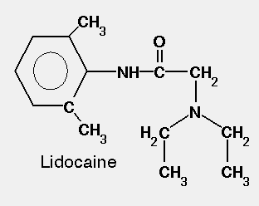
Lidocaine

Slide 107
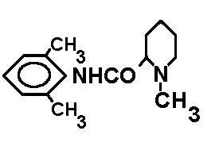
Mepivacaine

Slide 108
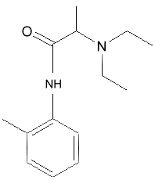
Prilocaine

Slide 109
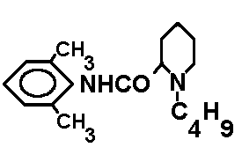
Bupivacaine

Slide 110
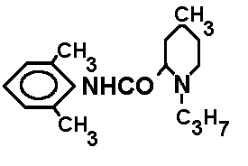
Ropivacaine

Slide 111
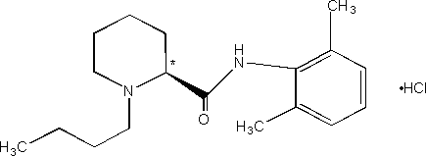
Levo-bupivacaine

Slide 112
Biotransformation and Excretion of Amide Local Anesthetics
Primary metabolism is by the microsomal P-450 enzymes in the liver (N-dealkylation and hydroxylation) and to a lesser extent by other tissues.
Rate of metabolism among amides varies according to the individual local anesthetic.

Slide 113
Biotransformation and Excretion of Amide Local Anesthetics
Rate of metabolism: prilocaine> lidocaine> mepivacaine> ropivacaine> bupivacaine.
Prilocaine metabolites include o-toluidine derivatives which can accumulate after large doses (>10 mg/kg) and result in methemoglobinemia.
Excretion of amides occurs in the kidneys. Less than 5% of the unchanged medication is excreted by the kidneys.

Slide 114
Patient Alterations to Pharmacokinetics
Age: elderly and newborns. Newborns have an immature hepatic enzyme system whereas the elderly have decreased hepatic blood flow.
Disease: any disease process that impairs blood flow to the liver or the livers ability to produce enzymes.

Slide 115
Clinical Pharmacology

Slide 116
General Considerations
Anesthetic potency
Onset of action
Duration of action
Differential sensory/motor blockade

Slide 117
Anesthetic Potency

Slide 118
Anesthetic Potency
Primary factor is the hydrophobicity (lipid solubility) of the local anesthetic.
Local anesthetics penetrate the nerve membrane and bind to Na+ channels (this is a hydrophobic site).

Slide 119
Factors that Affect Anesthetic Potency
Fiber size, type, and myelination
H+ ion balance
Vasodilator/vasoconstrictor properties of the individual local anesthetic
Frequency of nerve stimulation
pH (acidic environment will antagonize the block)
Electrolyte concentrations (hypokalemia and hypercalcemia antagonizes blockade)

Slide 120
Onset of Action

Slide 121
Onset of Action is related to:
pKa- when the pKa approximates the physiologic pH a higher concentration of non-ionized base is available…increasing the onset of action.
Dose- the higher the dose of local anesthetic the quicker the onset will be.
Concentration- higher concentrations of local anesthetic will increase onset of action

Slide 122
Duration of Action

Slide 123
Duration of Action
Is dependent on the individual local anesthetic characteristics.

Slide 124
Duration of Action: Classification of Local Anesthetics
Short acting: procaine, chloroprocaine
Moderate acting: lidocaine, mepivacaine, prilocaine.
Long acting: tetracaine, bupivacaine, etidocaine

Slide 125
Duration of Action: peripheral vascular effects
Local anesthetics exhibit a biphasic effect on vascular smooth muscle.
Low sub-clinical doses vasoconstriction occurs.
Clinically relevant doses generally cause vasodilatation.

Slide 126
Duration of Action: peripheral vascular effects
Individual local anesthetics will exhibit different degrees of vasodilatation. (i.e. lidocaine > mepivacaine > prilocaine).

Slide 127
Intrinsic Effect of Local Anesthetic on Vasculature
Lidocaine
Bupivacaine
Mepivacaine
Ropivacaine
Vasodilatation
Vasoconstriction
Intrinsic effect of individual local anesthetics do not have a clinically significant effect.

Slide 128
Duration of Action: peripheral vascular effects
The effects of individual local anesthetics on vascular tone is complex and dependent on:
1. concentration
2. time
3. type of vascular bed

Slide 129
Differential Sensory/Motor Blockade

Slide 130
Sensory/Motor Blockade
Individual local anesthetics have the ability to produce different degree’s of sensory and motor blockade.
i.e. bupivacaine and etidocaine are both long acting and potent anesthetics however bupivacaine exhibits a more effective sensory blockade than sensory whereas etidocaine exhibits an equally effective sensory and motor block.
Ropivacaine, on the other hand, exhibits a potent sensory block but less intense motor block.

Slide 131
Factors Affecting Local Anesthetic Activity in the Clinical Setting

Slide 132
Factors Affecting Local Anesthetic Activity in the Clinical Setting
Dose and volume
Addition of vasoconstrictors
Site of injection
Carbonation and pH adjustment
Mixtures of local anesthetics
Pregnancy

Slide 133
Factors Affecting Local Anesthetic Activity in the Clinical Setting: Dose
Increasing the dose will increase the success of the block as well as decrease the duration of onset (care must be taken not to administer a toxic dose!)
Increasing the volume of local anesthetics administered will increase the spread of the anesthesia.

Slide 134
Factors Affecting Local Anesthetic Activity in the Clinical Setting: Addition of Vasoconstrictors
Most common: epinephrine at a dose of 1:200,000 (5 mcg/ml) for peripheral nerve blocks and epidural blockade. 0.1-0.2 mg for spinal blockade.

Slide 135
Factors Affecting Local Anesthetic Activity in the Clinical Setting: Addition of Vasoconstrictors
Norepinephrine and phenylephrine have been used as vasoconstrictors for regional anesthesia but do not exhibit addition properties that make them superior to epinephrine.

Slide 136
Factors Affecting Local Anesthetic Activity in the Clinical Setting: Addition of Vasoconstrictors
Epinephrine decreases vascular absorption- more local anesthetic molecules are able to reach the nerve membrane. This acts to improve the depth and duration of blockade.
Epinephrine will prolong the duration of blockade for most local anesthetics.

Slide 137
Factors Affecting Local Anesthetic Activity in the Clinical Setting: Addition of Vasoconstrictors
For local anesthetics in the subarachnoid and epidural spaces epinephrine does not generally prolong the duration of action; there is still a benefit of adding it. This is related to the activation of endogenous analgesic mechanisms through alpha adrenergic receptor activation which improves analgesic action.
In addition it will decrease the absorption of the local anesthetic when placed in the epidural space.

Slide 138
Factors Affecting Local Anesthetic Activity in the Clinical Setting: Site of Injection
Anatomical location of the block influences the onset and duration due to the effect on rate of diffusion, vascular absorption, and the dose, concentration, and volume of local anesthetic used.

Slide 139
Factors Affecting Local Anesthetic Activity in the Clinical Setting: Site of Injection
Subarachnoid blockade exhibits the quickest onset and shortest duration.
Why? Rapid onset is due to the fact that there is no nerve sheath to penetrate. Short duration is related to the small dose and volume used.

Slide 140
Factors Affecting Local Anesthetic Activity in the Clinical Setting: Site of Injection
Brachial plexus blockade on the other hand has the slowest onset and longest duration.
Why? Local anesthetics are deposited in the sheath surrounding the brachial plexus. Diffusion must occur before reaching the nerve membrane. The long duration is due to a slower rate of absorption, large doses, and long segments of nerve exposure to local anesthetics.

Slide 141
Factors Affecting Local Anesthetic Activity in the Clinical Setting: Carbonation and pH adjustment
In the isolated nerve the addition of sodium bicarbonate or CO2 will accelerate onset and minimum concentration required for blockade.
Bicarbonate will increase pH, bringing it closer to physiologic pH, and increase the amount of uncharged base that is available.

Slide 142
Factors Affecting Local Anesthetic Activity in the Clinical Setting: Site of Injection
Increased amounts of uncharged base will increase the rate of diffusion across the sheath and membrane.
Controversy exists concerning if this occurs clinically. Ambiguity exists due to different study protocols. Need consistent study parameters to know if this occurs clinically, with which block and with what local anesthetic.

Slide 143
Factors Affecting Local Anesthetic Activity in the Clinical Setting: Mixtures of Local Anesthetics
Some clinicians will mix a local anesthetic with a fast onset with a local anesthetic that has a long duration of action.
Studies have yielded mixed results on the effectiveness of this technique.

Slide 144
Factors Affecting Local Anesthetic Activity in the Clinical Setting: Mixtures of Local Anesthetics
Chloroprocaine and bupivacaine in the brachial plexus exhibits a fast onset and long duration of blockade- however in the epidural space the duration was shorter than if bupivacaine was used alone.

Slide 145
Factors Affecting Local Anesthetic Activity in the Clinical Setting: Mixtures of Local Anesthetics
Few advantages clinically.
The advent of peripheral nerve catheters allow us to have the ability to extend a block for an extended period of time.
Risk of toxicity remains. Should not exceed the maximum dose of either local anesthetic. A solution containing 50% of the toxic dose for one local anesthetic combined with 50% of the toxic dose of another local anesthetic will = 100% toxic dose.

Slide 146
Factors Affecting Local Anesthetic Activity in the Clinical Setting: Pregnancy
Hormonal changes enhance the potency of local anesthetics.
Mechanical factors add to the risk. Epidural veins are dilated, decreasing the volume in the epidural and subarachnoid space…plays a minor role.

Slide 147
Factors Affecting Local Anesthetic Activity in the Clinical Setting: Pregnancy
Spread and depth of epidural and spinal anesthesia in greater in the parturient when compared to the non-parturient.
Increased spread of local anesthetic has been found to occur as early as the first trimester.
Correlation between progesterone levels and the mg per segment requirement for lidocaine.
The dose of local anesthetics should be reduced for any parturient regardless of the stage of pregnancy.

Slide 148
Medication Interactions with Local Anesthetics

Slide 149
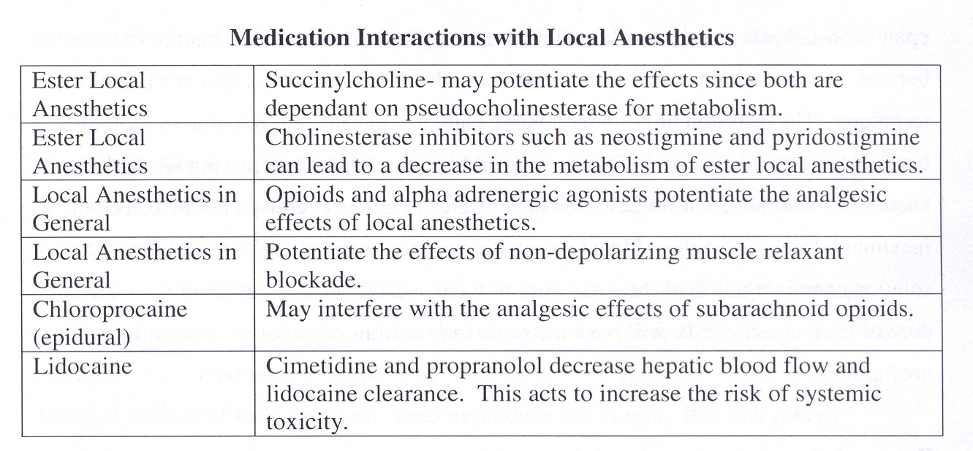

Slide 150
References
Heavner, J.E. (2008). Pharmacology of local anesthetics. In D.E. Longnecker et al (eds) Anesthesiology. New York: McGraw-Hill Medical.
Joyce, J.A. (2002). A pathway toward safer anesthesia: stereochemical advances. AANA Journal, 70, 63-67.
Katzung, B.G. (1992). Section 1: basic principles. In B.G. Katzung Basic & clinical pharmacology, 5th edition. Norwalk, Connecticut: Appleton and Lange.
Morgan, G.E., Mikhail, M.S., Murray, M.J. (2006). Local Anesthetics. In G.E. Morgan et al Clinical Anesthesiology, 4th edition. New York: Lange Medical Books.
Stoelting, R.K. & Hillier, S.C. (2006). Pharmacology and pharmacodynamics of injected and inhaled drugs. In R.K. Stoelting & S.C. Hillier (eds) Pharmacology & Physiology in Anesthetic Practice, 4th edition. Philadelphia: Lippincott Williams & Wilkins.
Strichartz, G.R. & Berde, C.B. (2005). Local Anesthetics. In R.D. Miller Miller’s Anesthesia, 6th edition. Philadelphia: Elsevier Churchill Livingstone.

